Slide 1

Court Management System
Project Presentation for Streamlined Court Operations
By
i220786 Bilal Khawar
i221293 Saffi Hashir
i221239 Tauha Imran

Slide 2

Introduction
1
Project Purpose
2
Product Scope
Enhance court efficiency, accessibility, and transparency.
Manage cases, hearings, and court records.
3
Objectives
4
Problem Statement
Streamline court processes, reduce backlog.
Modernize the judicial system resolving inefficiencies and manual processes.

Slide 3
Overall Description
Product Perspective
Use Cases
Comprehensive system for court administration.
File and Schedule Case
Track and Manage Updates and Notifications
Track and Monitor Case
Register with a Bar
Submit a Document or Transcript
Schedule a Hearing or Witness
Review a Document and Log Judgement
Perform IT system maintenance
Re-Open Case
Close Case
Product Functions
Case management
Document Handling
Scheduling/Calendar Management
User Interface
Reporting & Analytics

Slide 4
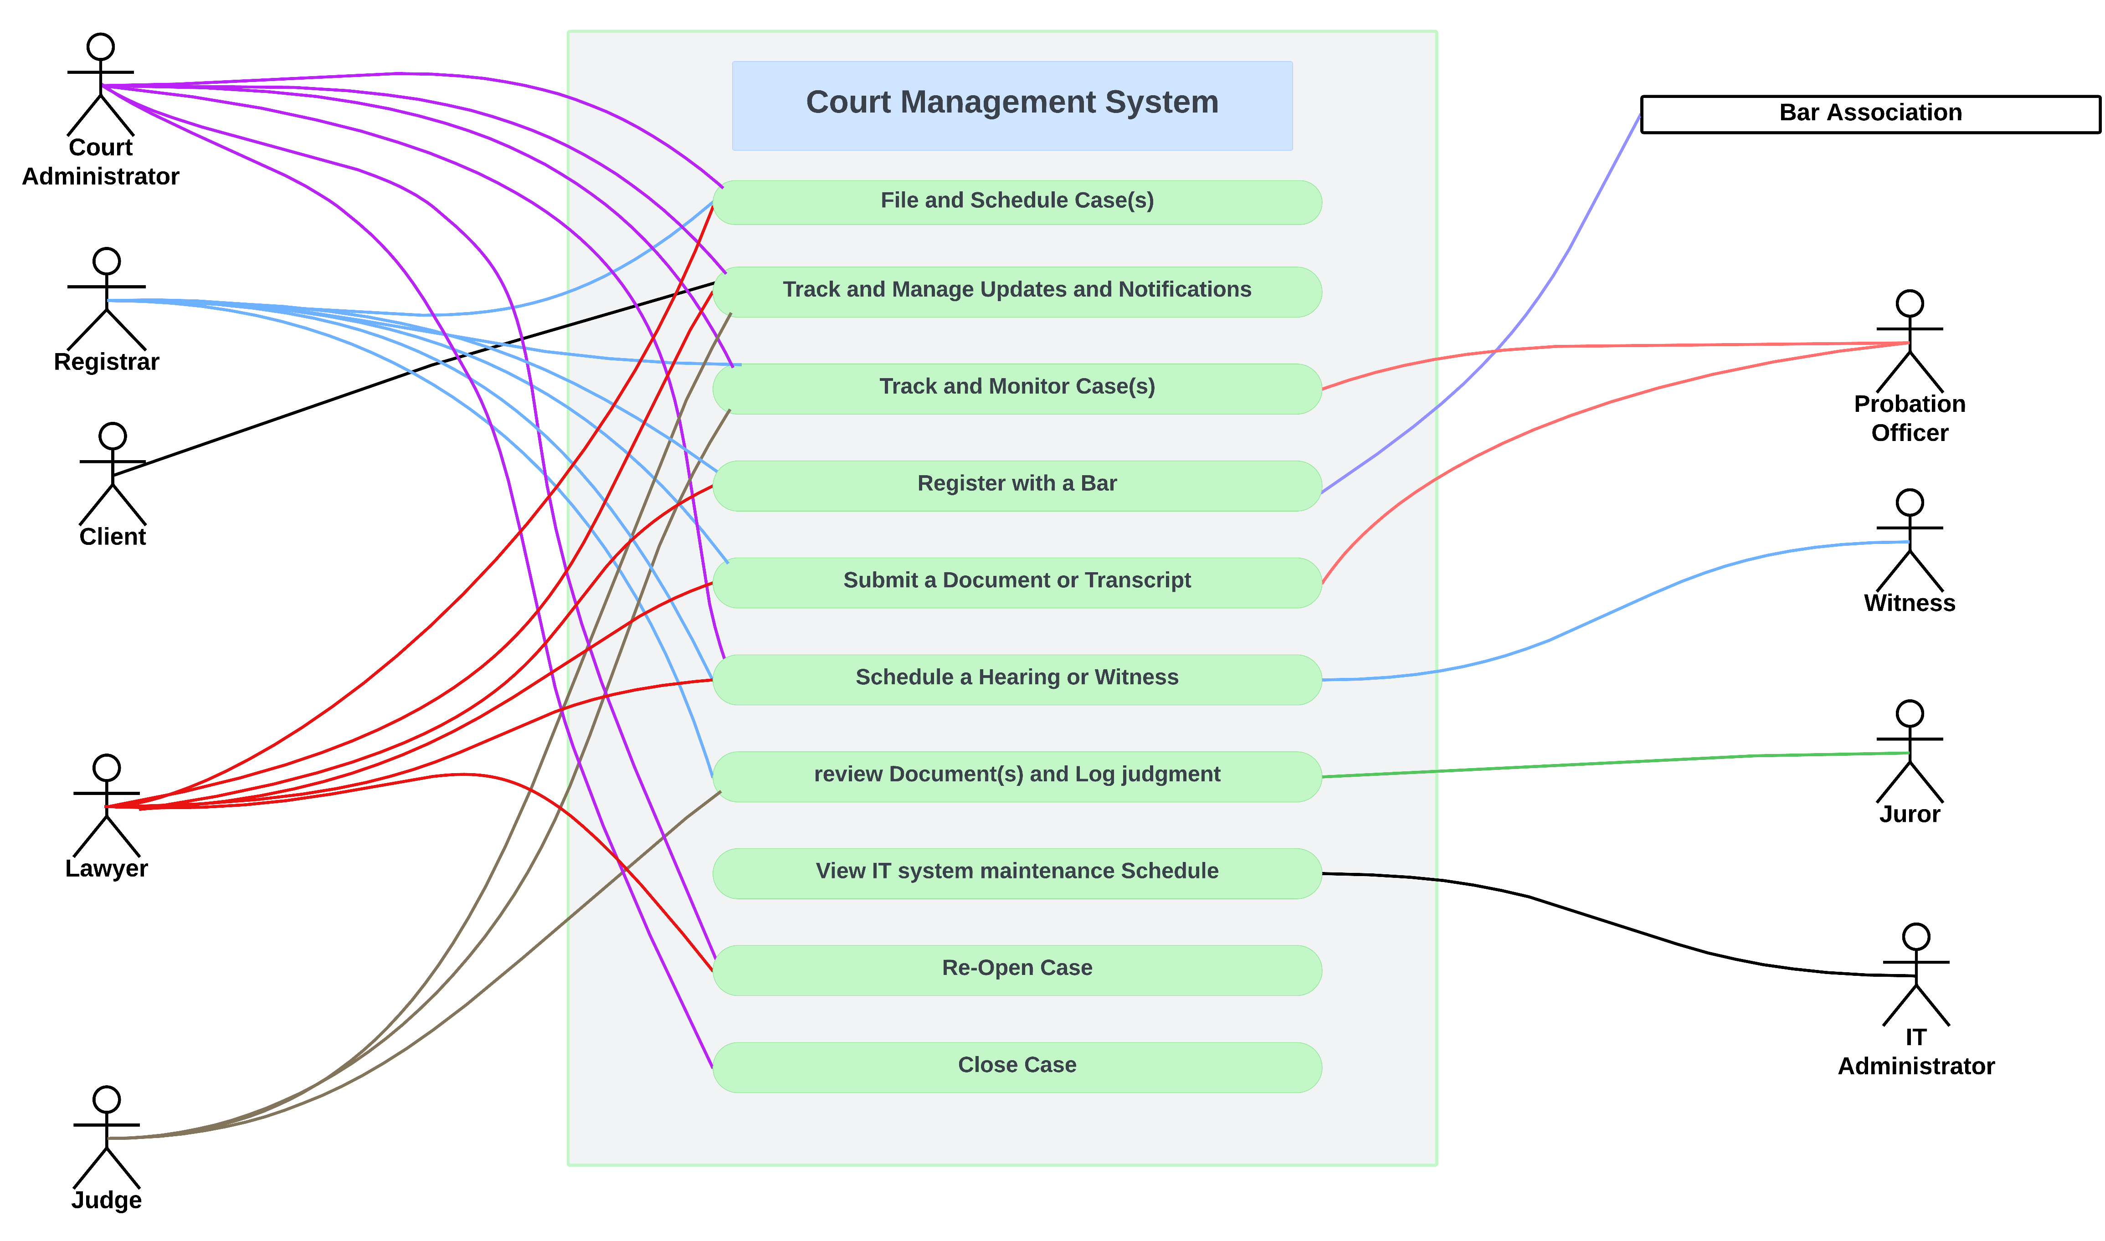
Use Case Diagram
Visual representation of system functionality.

Slide 5
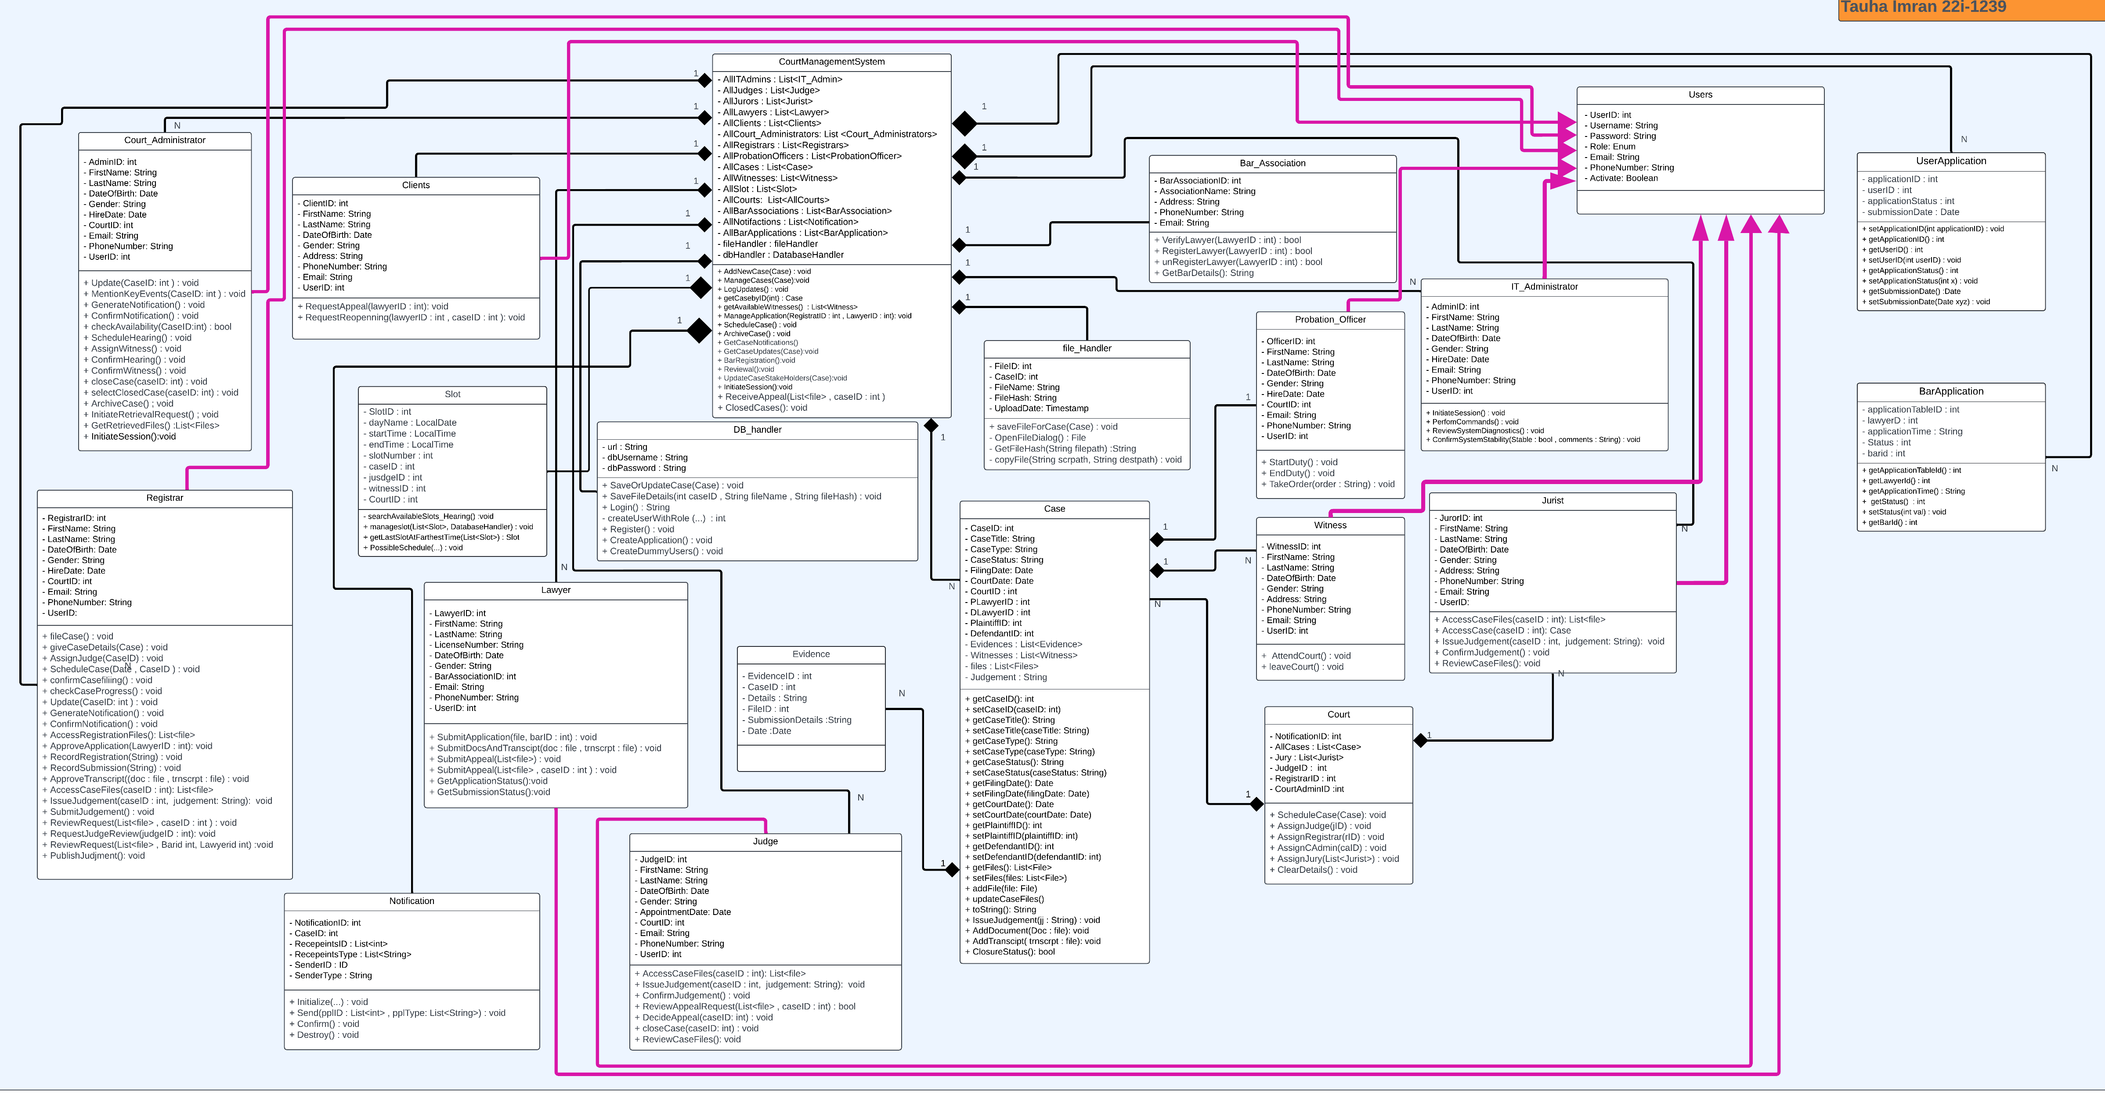
Class Diagram
Diagram of Classes.

Slide 6
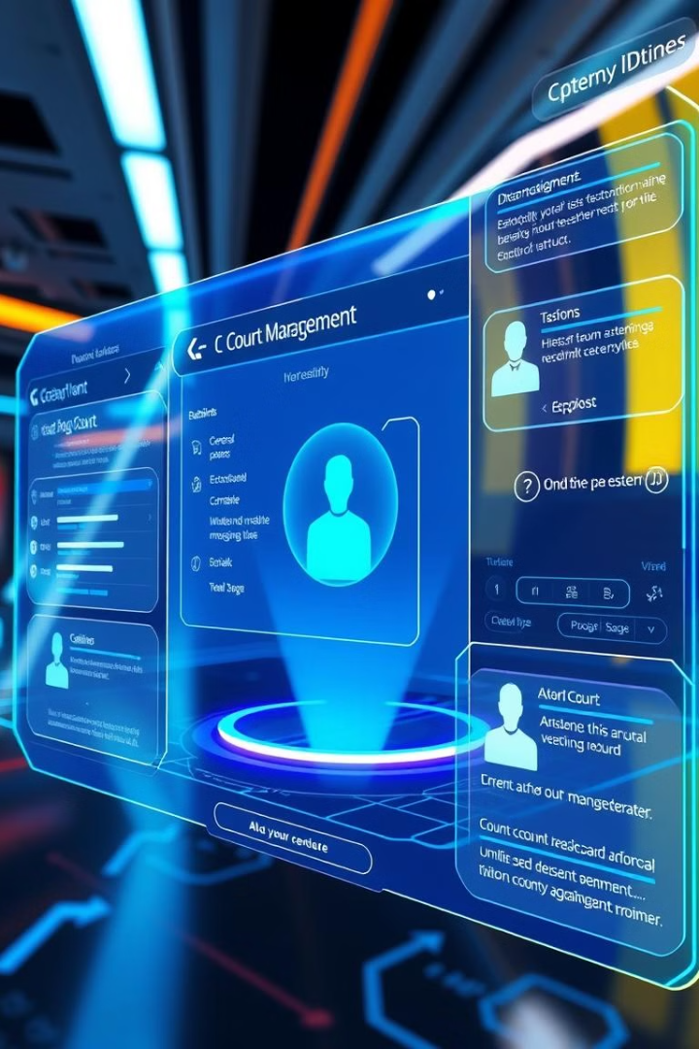
Nonfunctional Requirements
Performance Requirements
Security Requirements
Data security is a top priority.
System must be responsive and scalable.
Software Quality Attributes
User Interfaces
Intuitive and accessible for all users.
Reliability, maintainability, and usability.

Slide 7
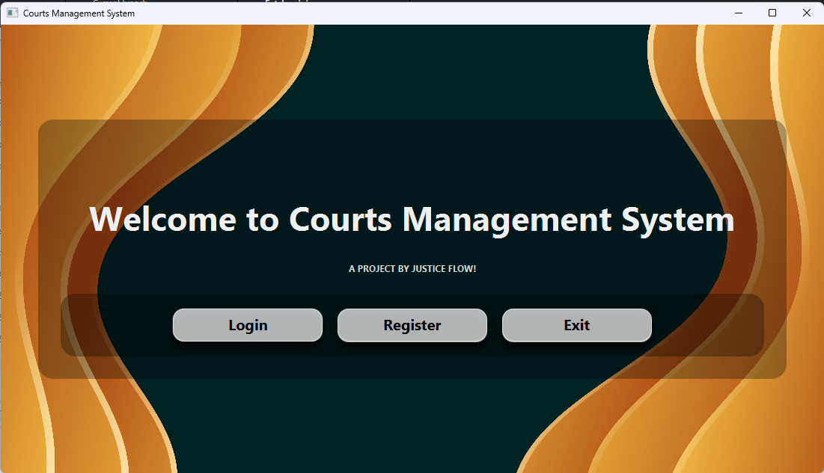
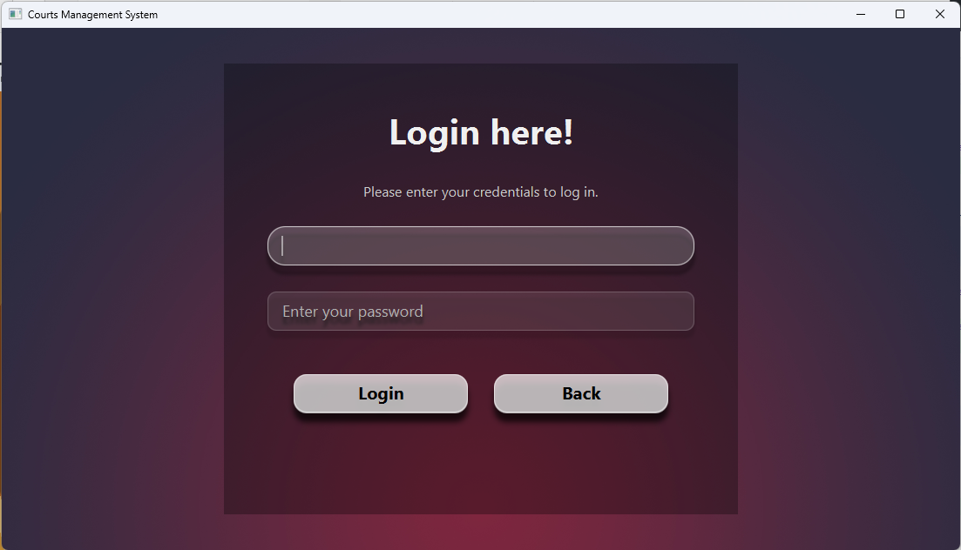
Interface Preview

Slide 8
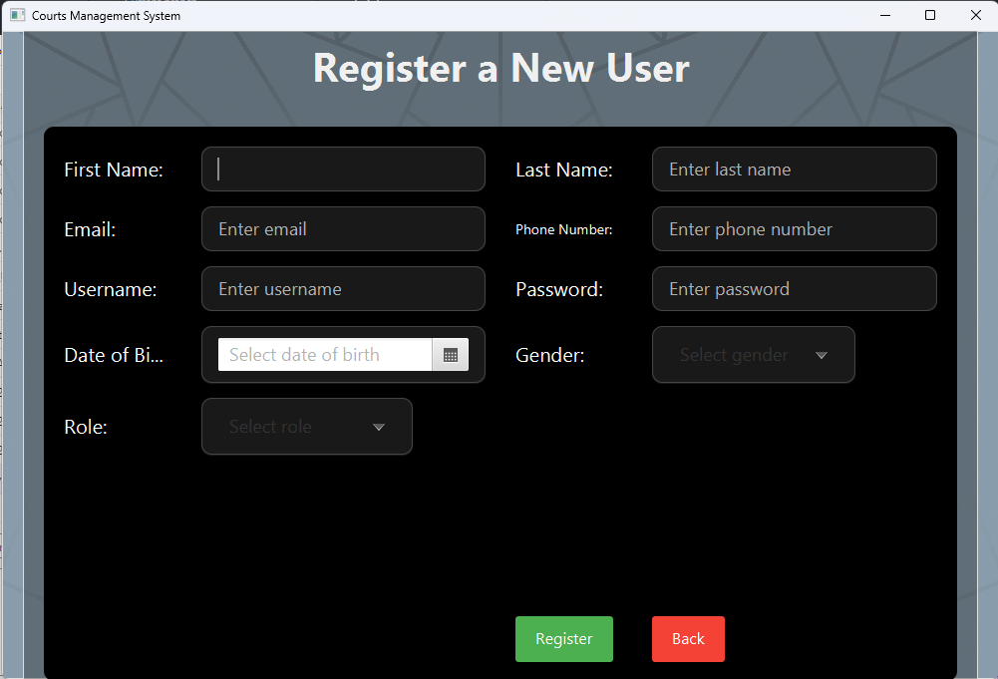
Interface Preview

Slide 9
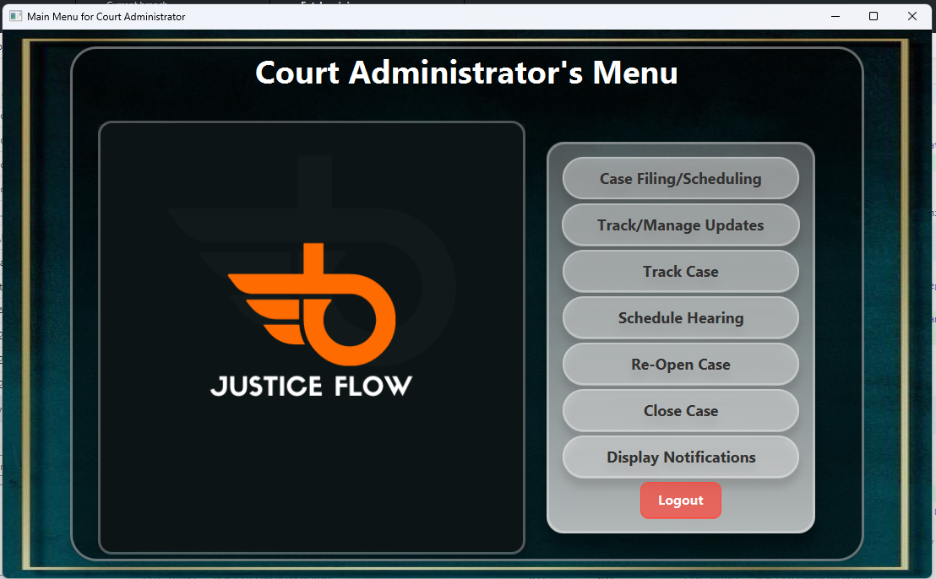
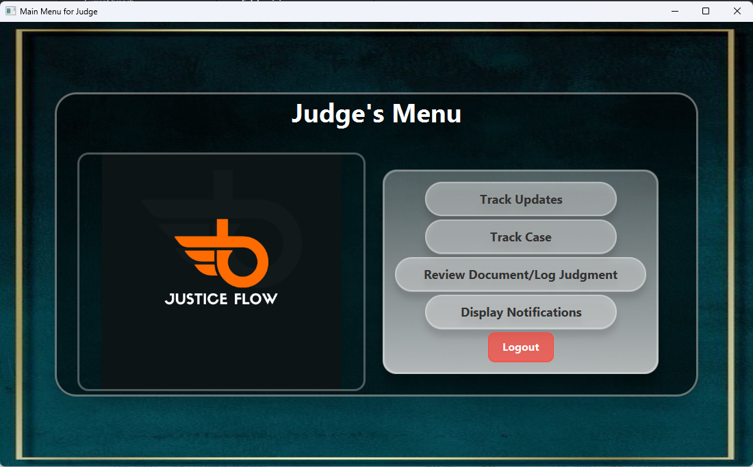
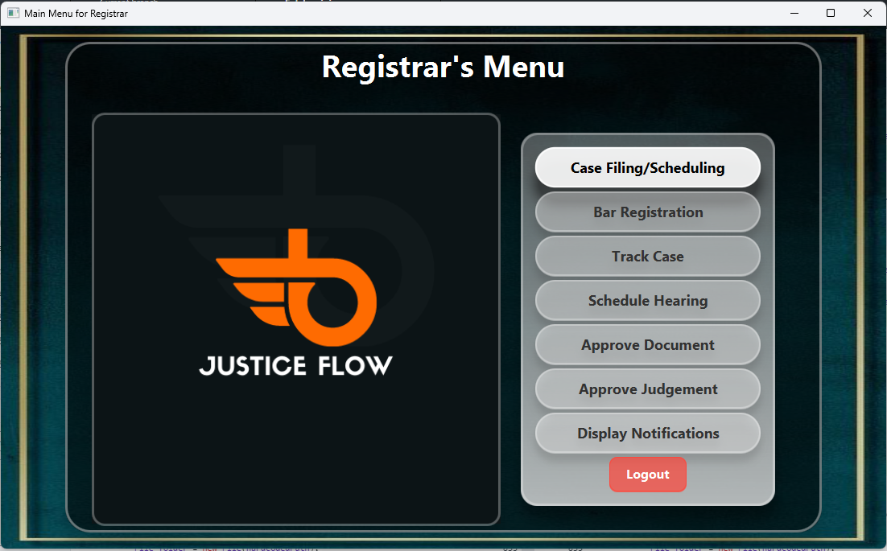
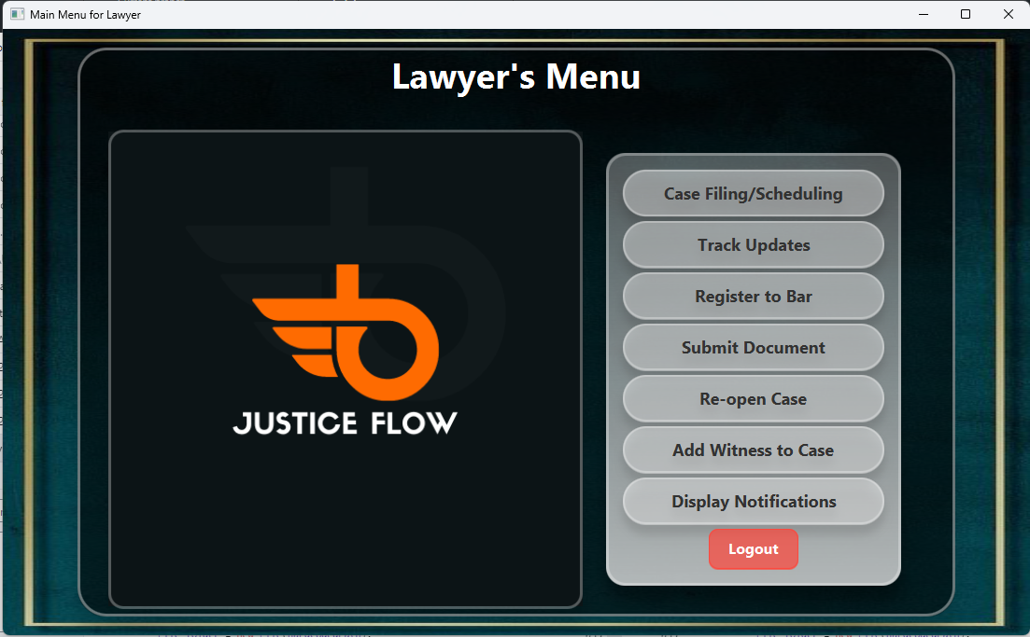
Interface Preview

Slide 10
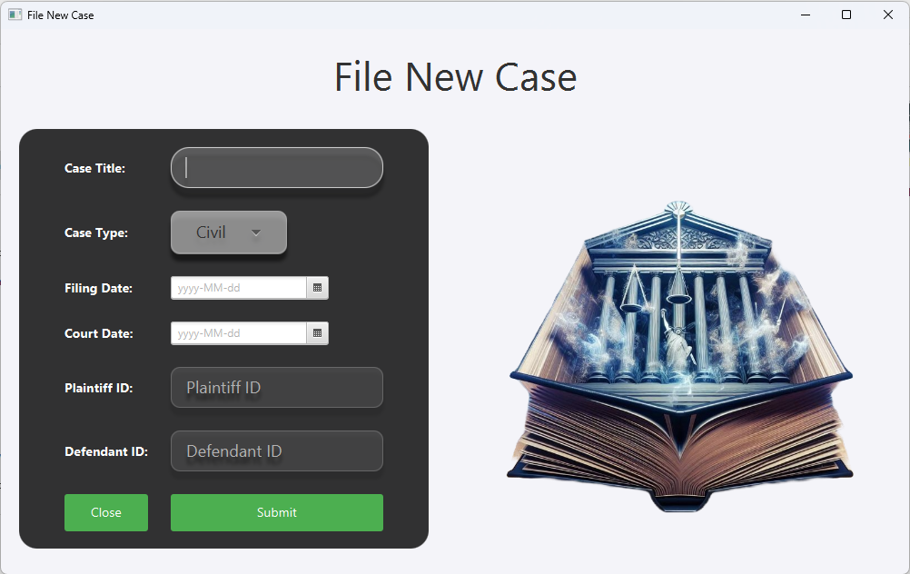
Interface Preview

Slide 11
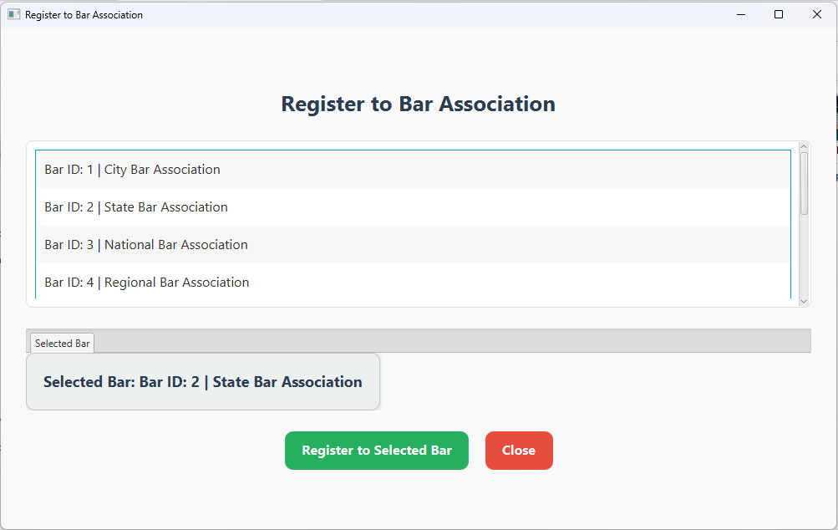
Interface Preview

Slide 12
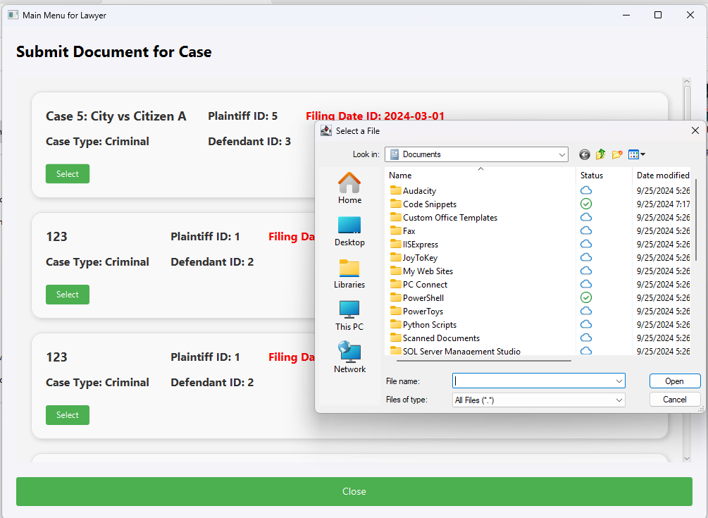
Interface Preview

Slide 13
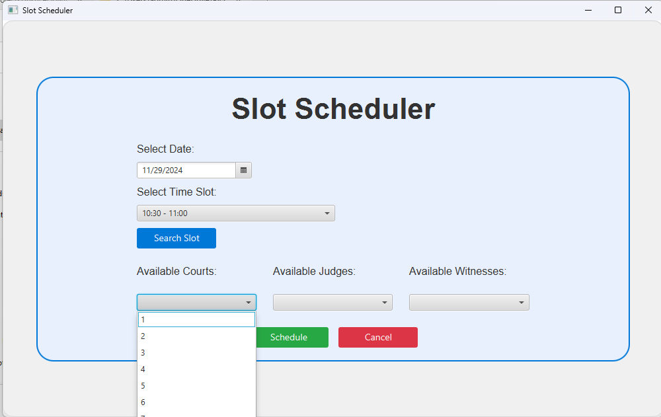
Interface Preview

Slide 14
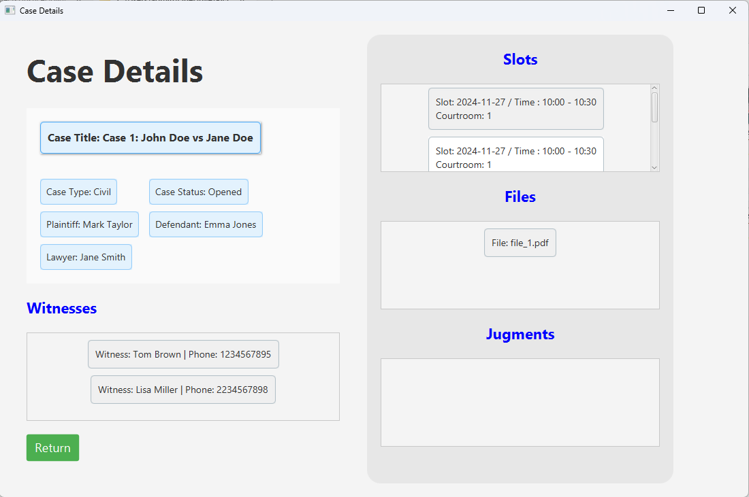
Interface Preview

Slide 15
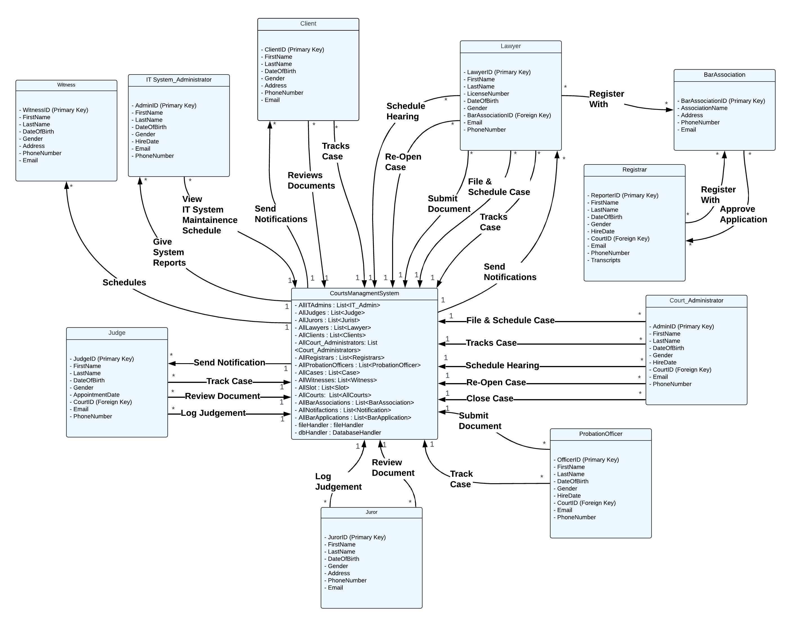
Domain Model
Conceptual model of the
system’s interactions.

Slide 16
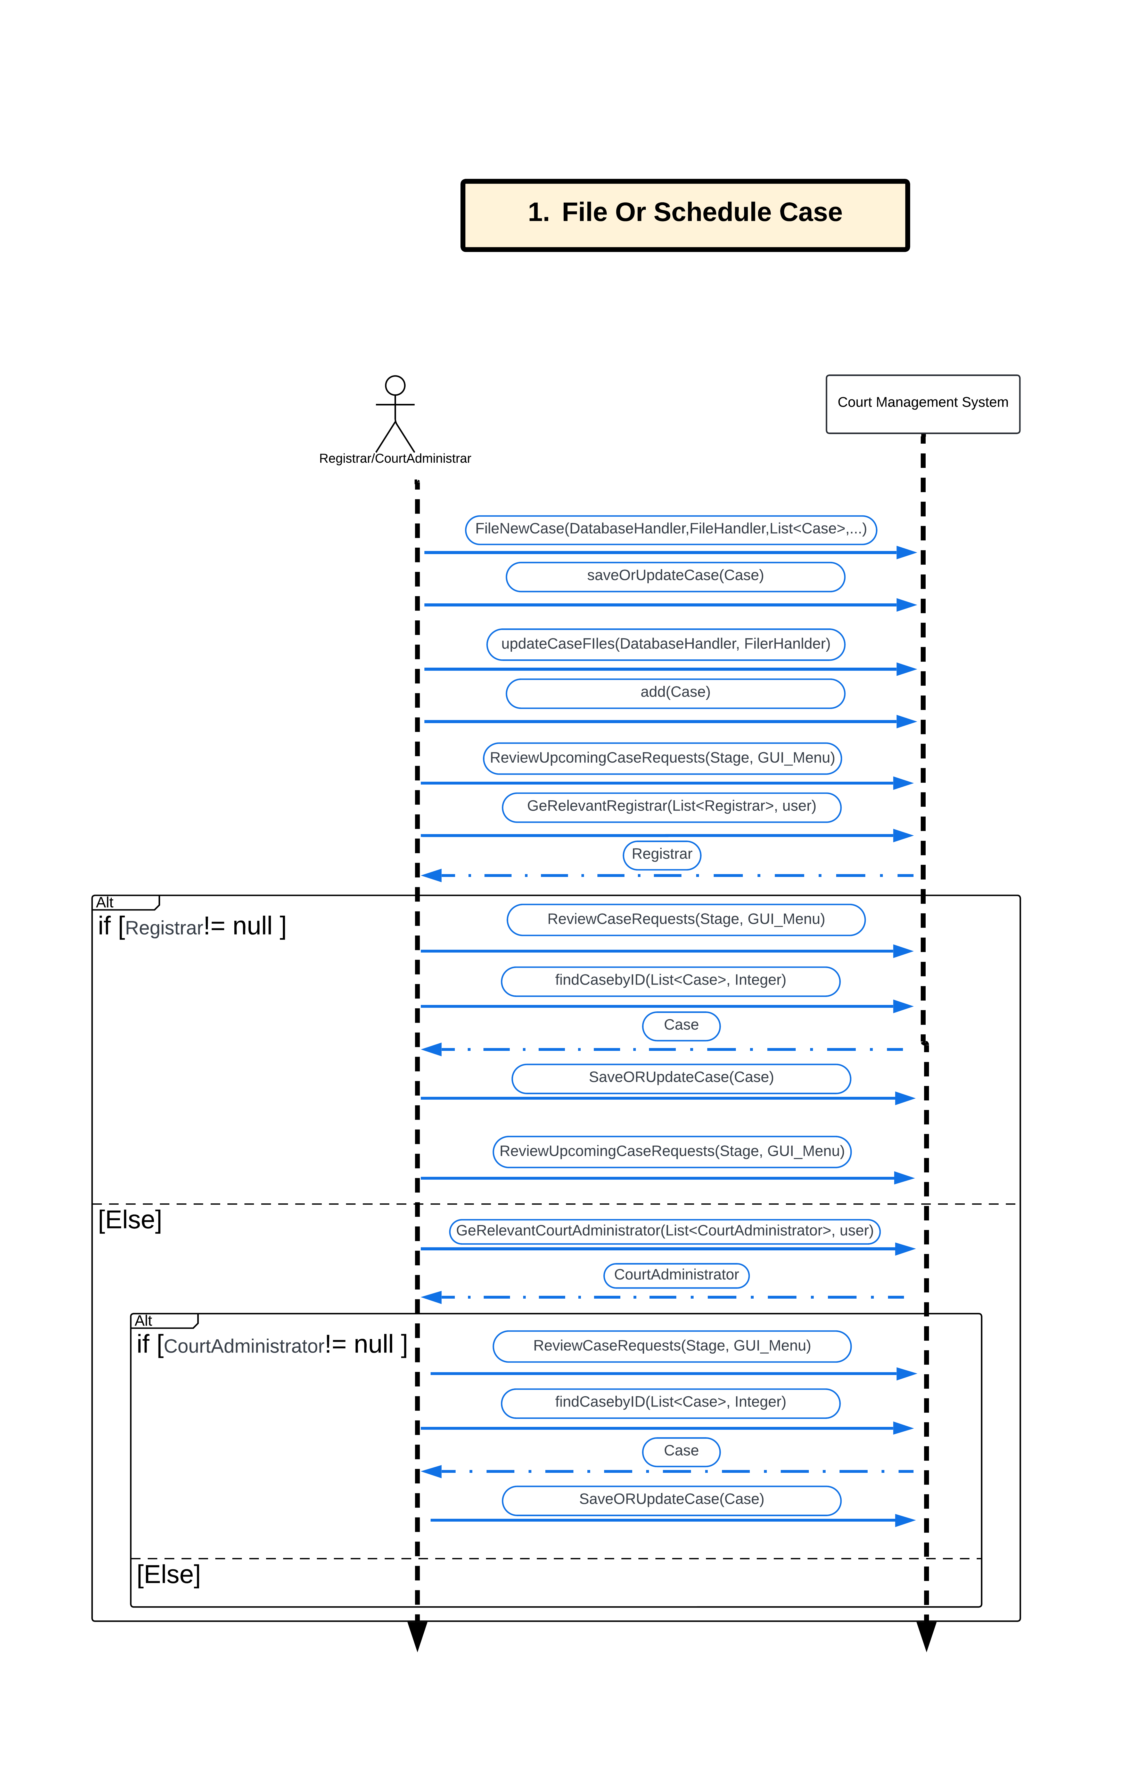
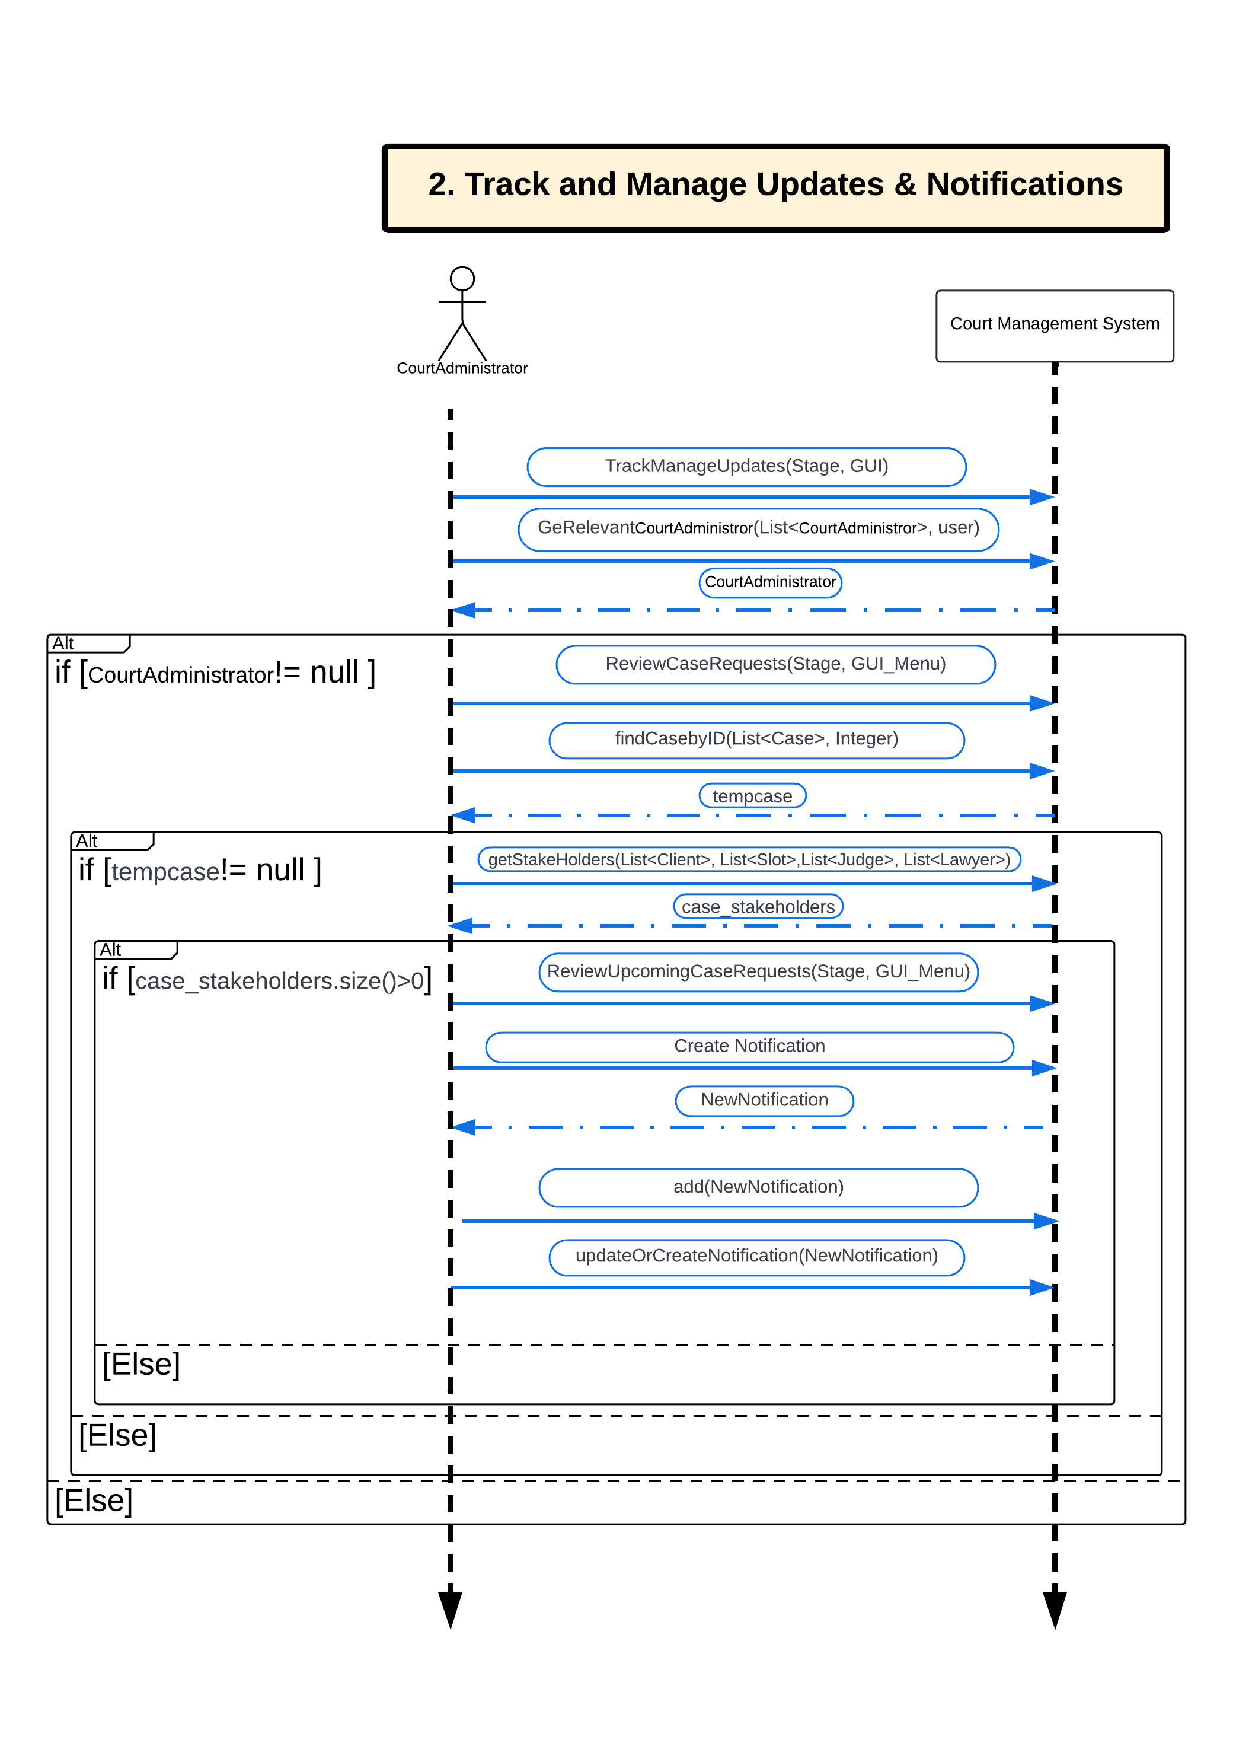
System
Sequence
Diagram
Interaction between
actors and the system.

Slide 17
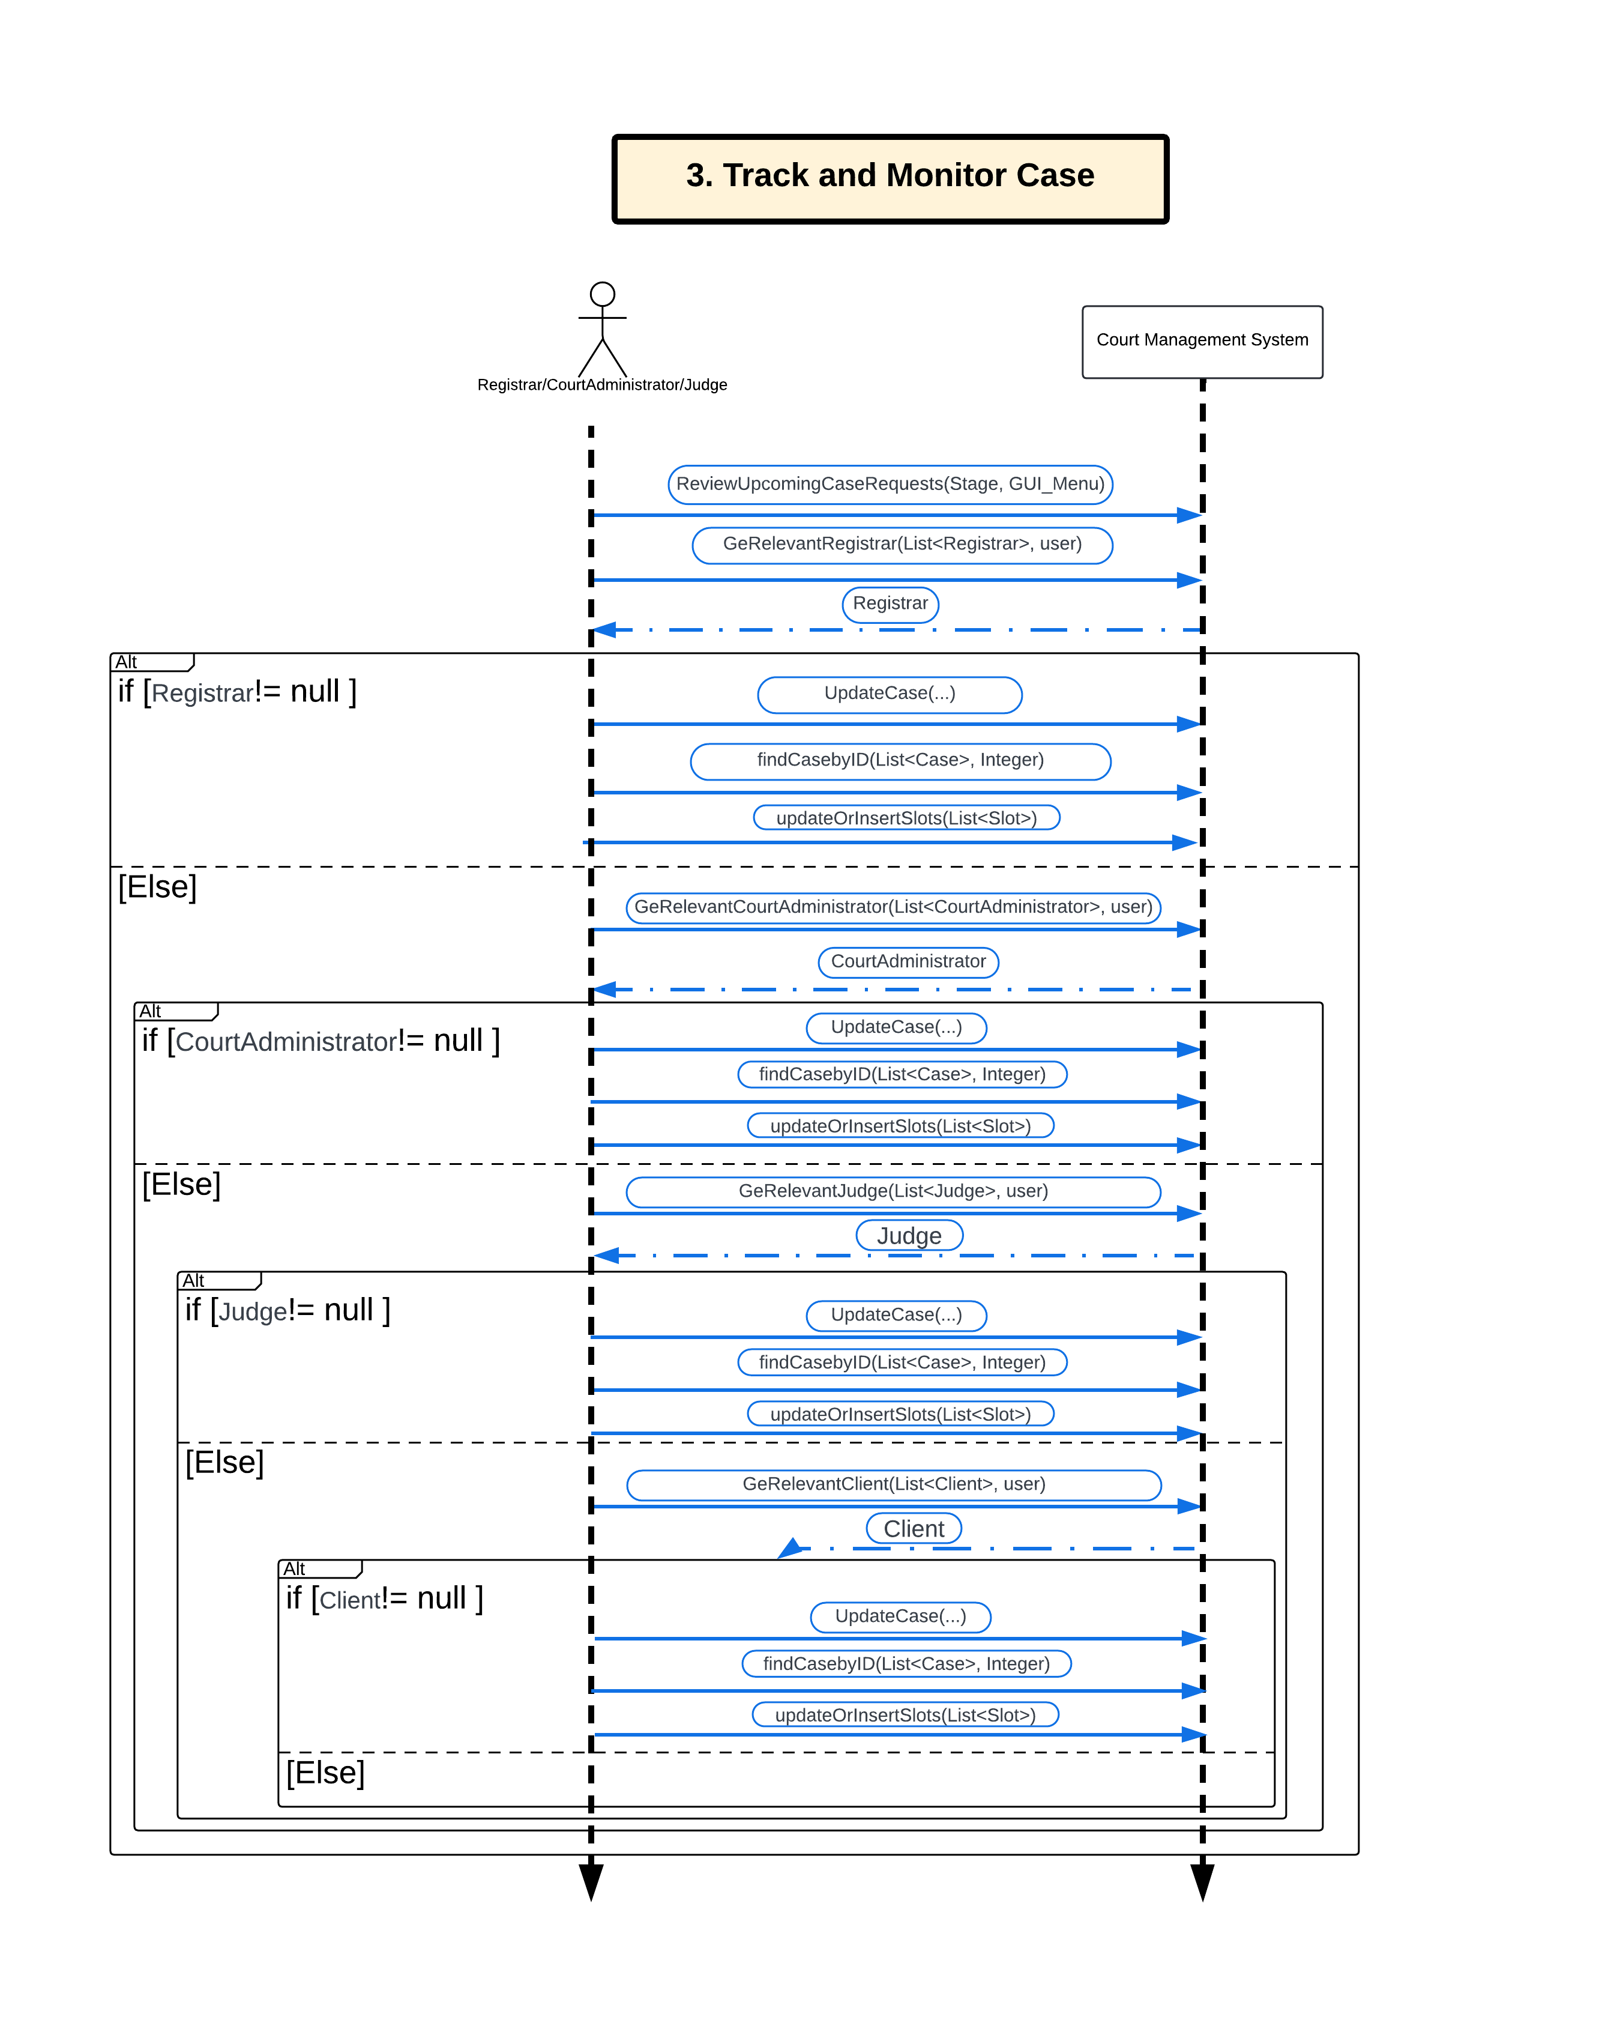
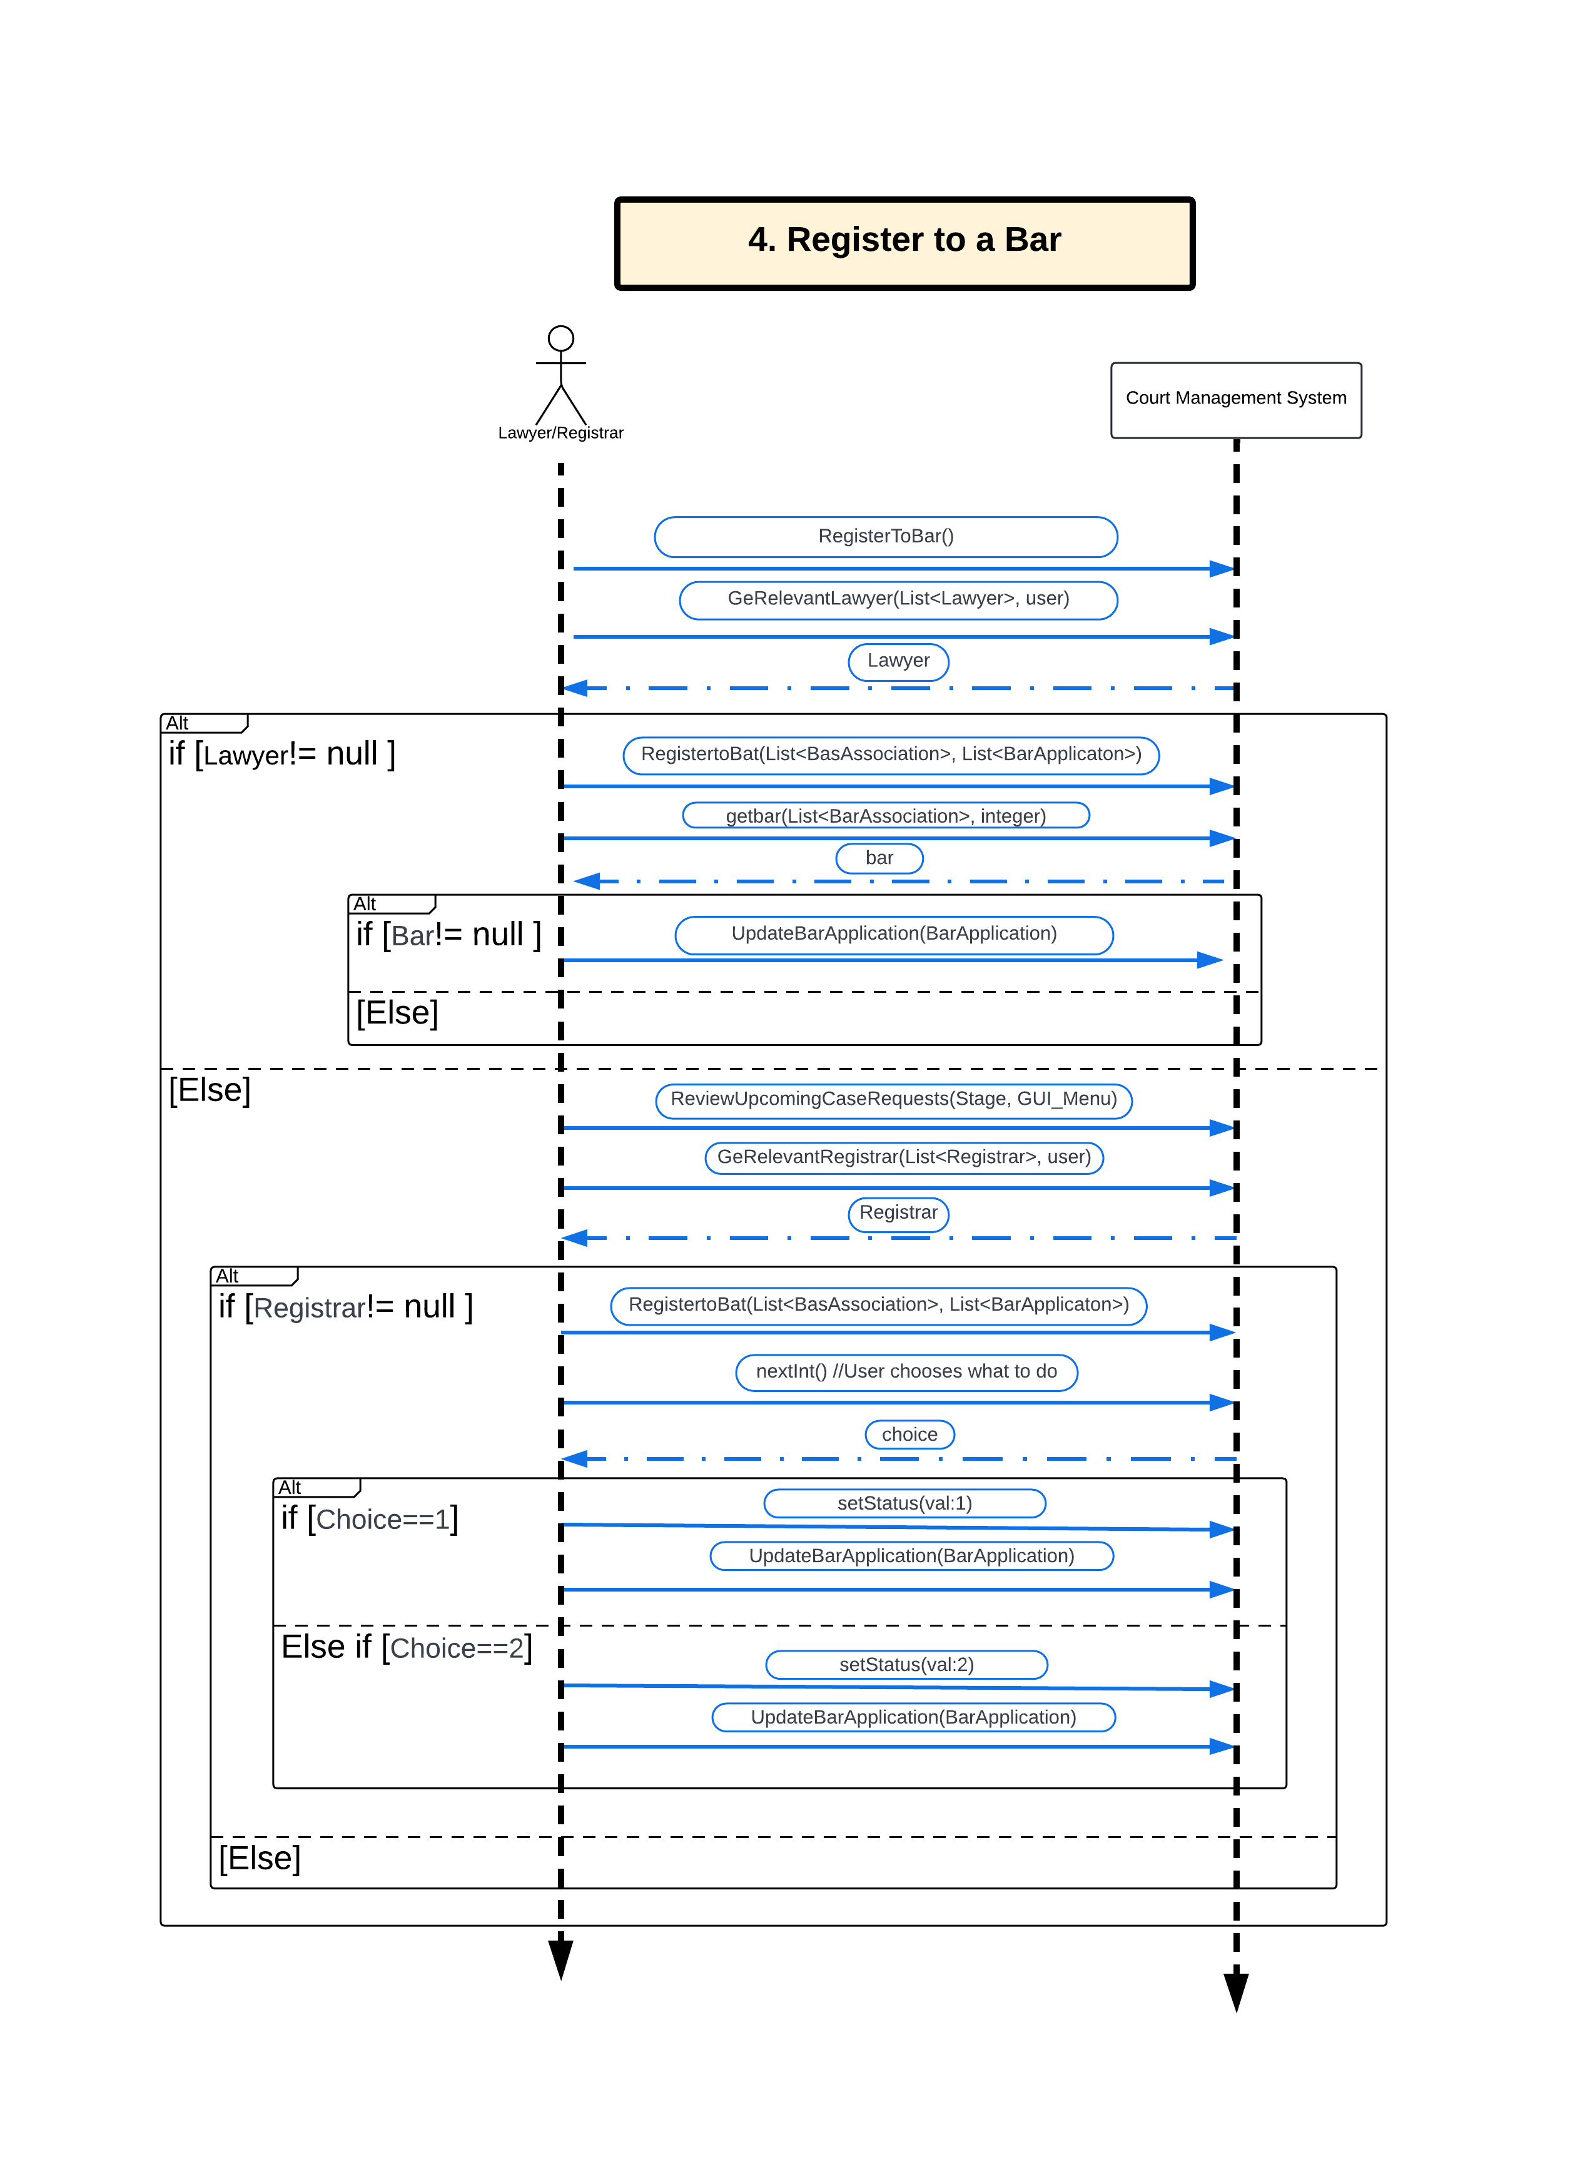
System
Sequence
Diagram
Interaction between
actors and the system.

Slide 18
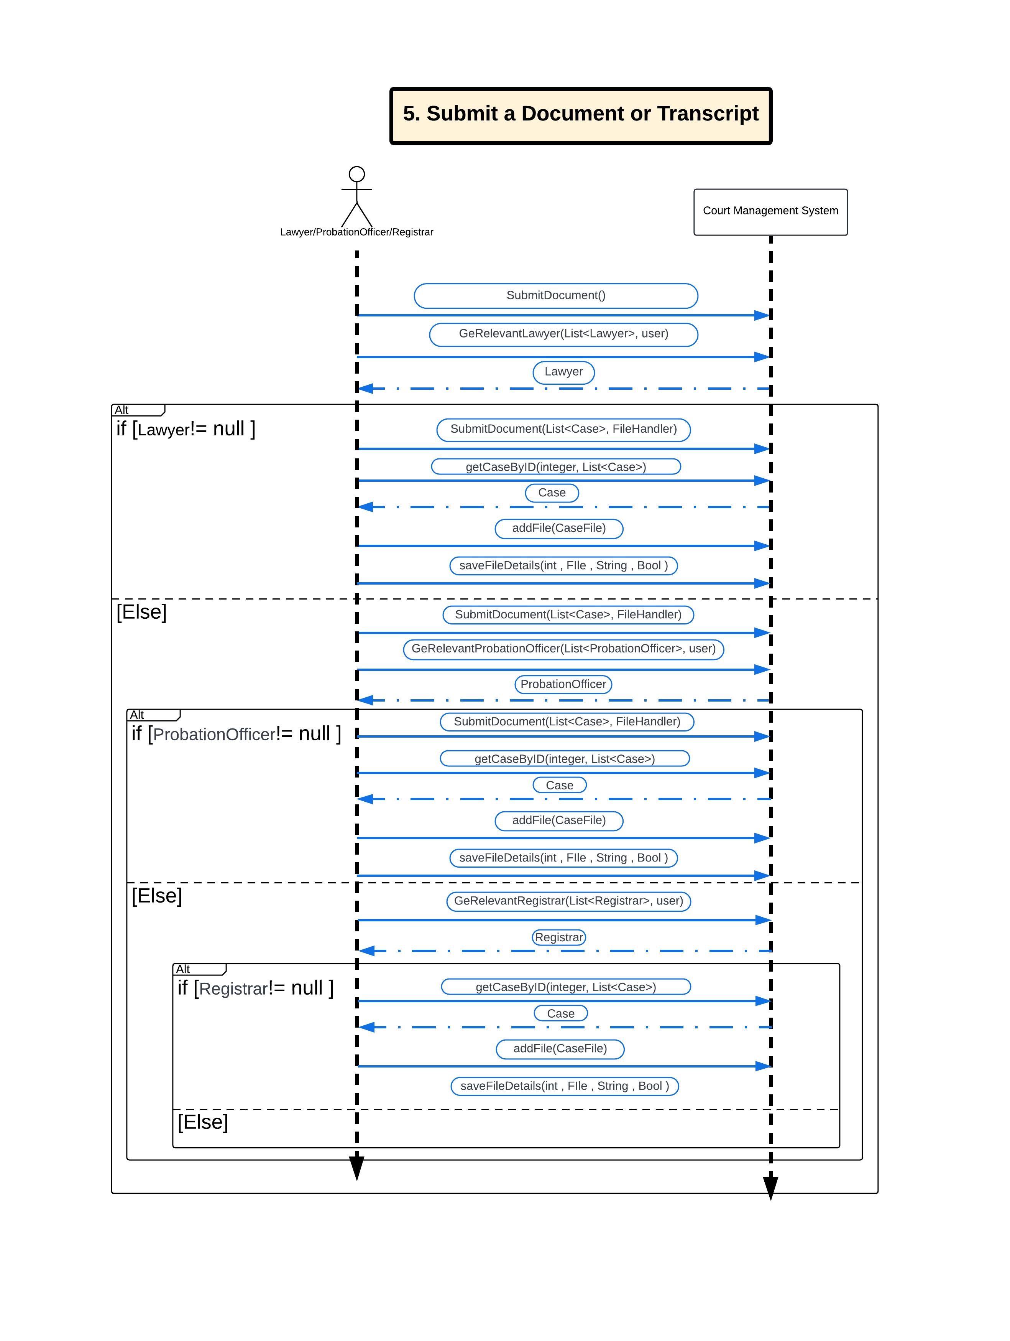
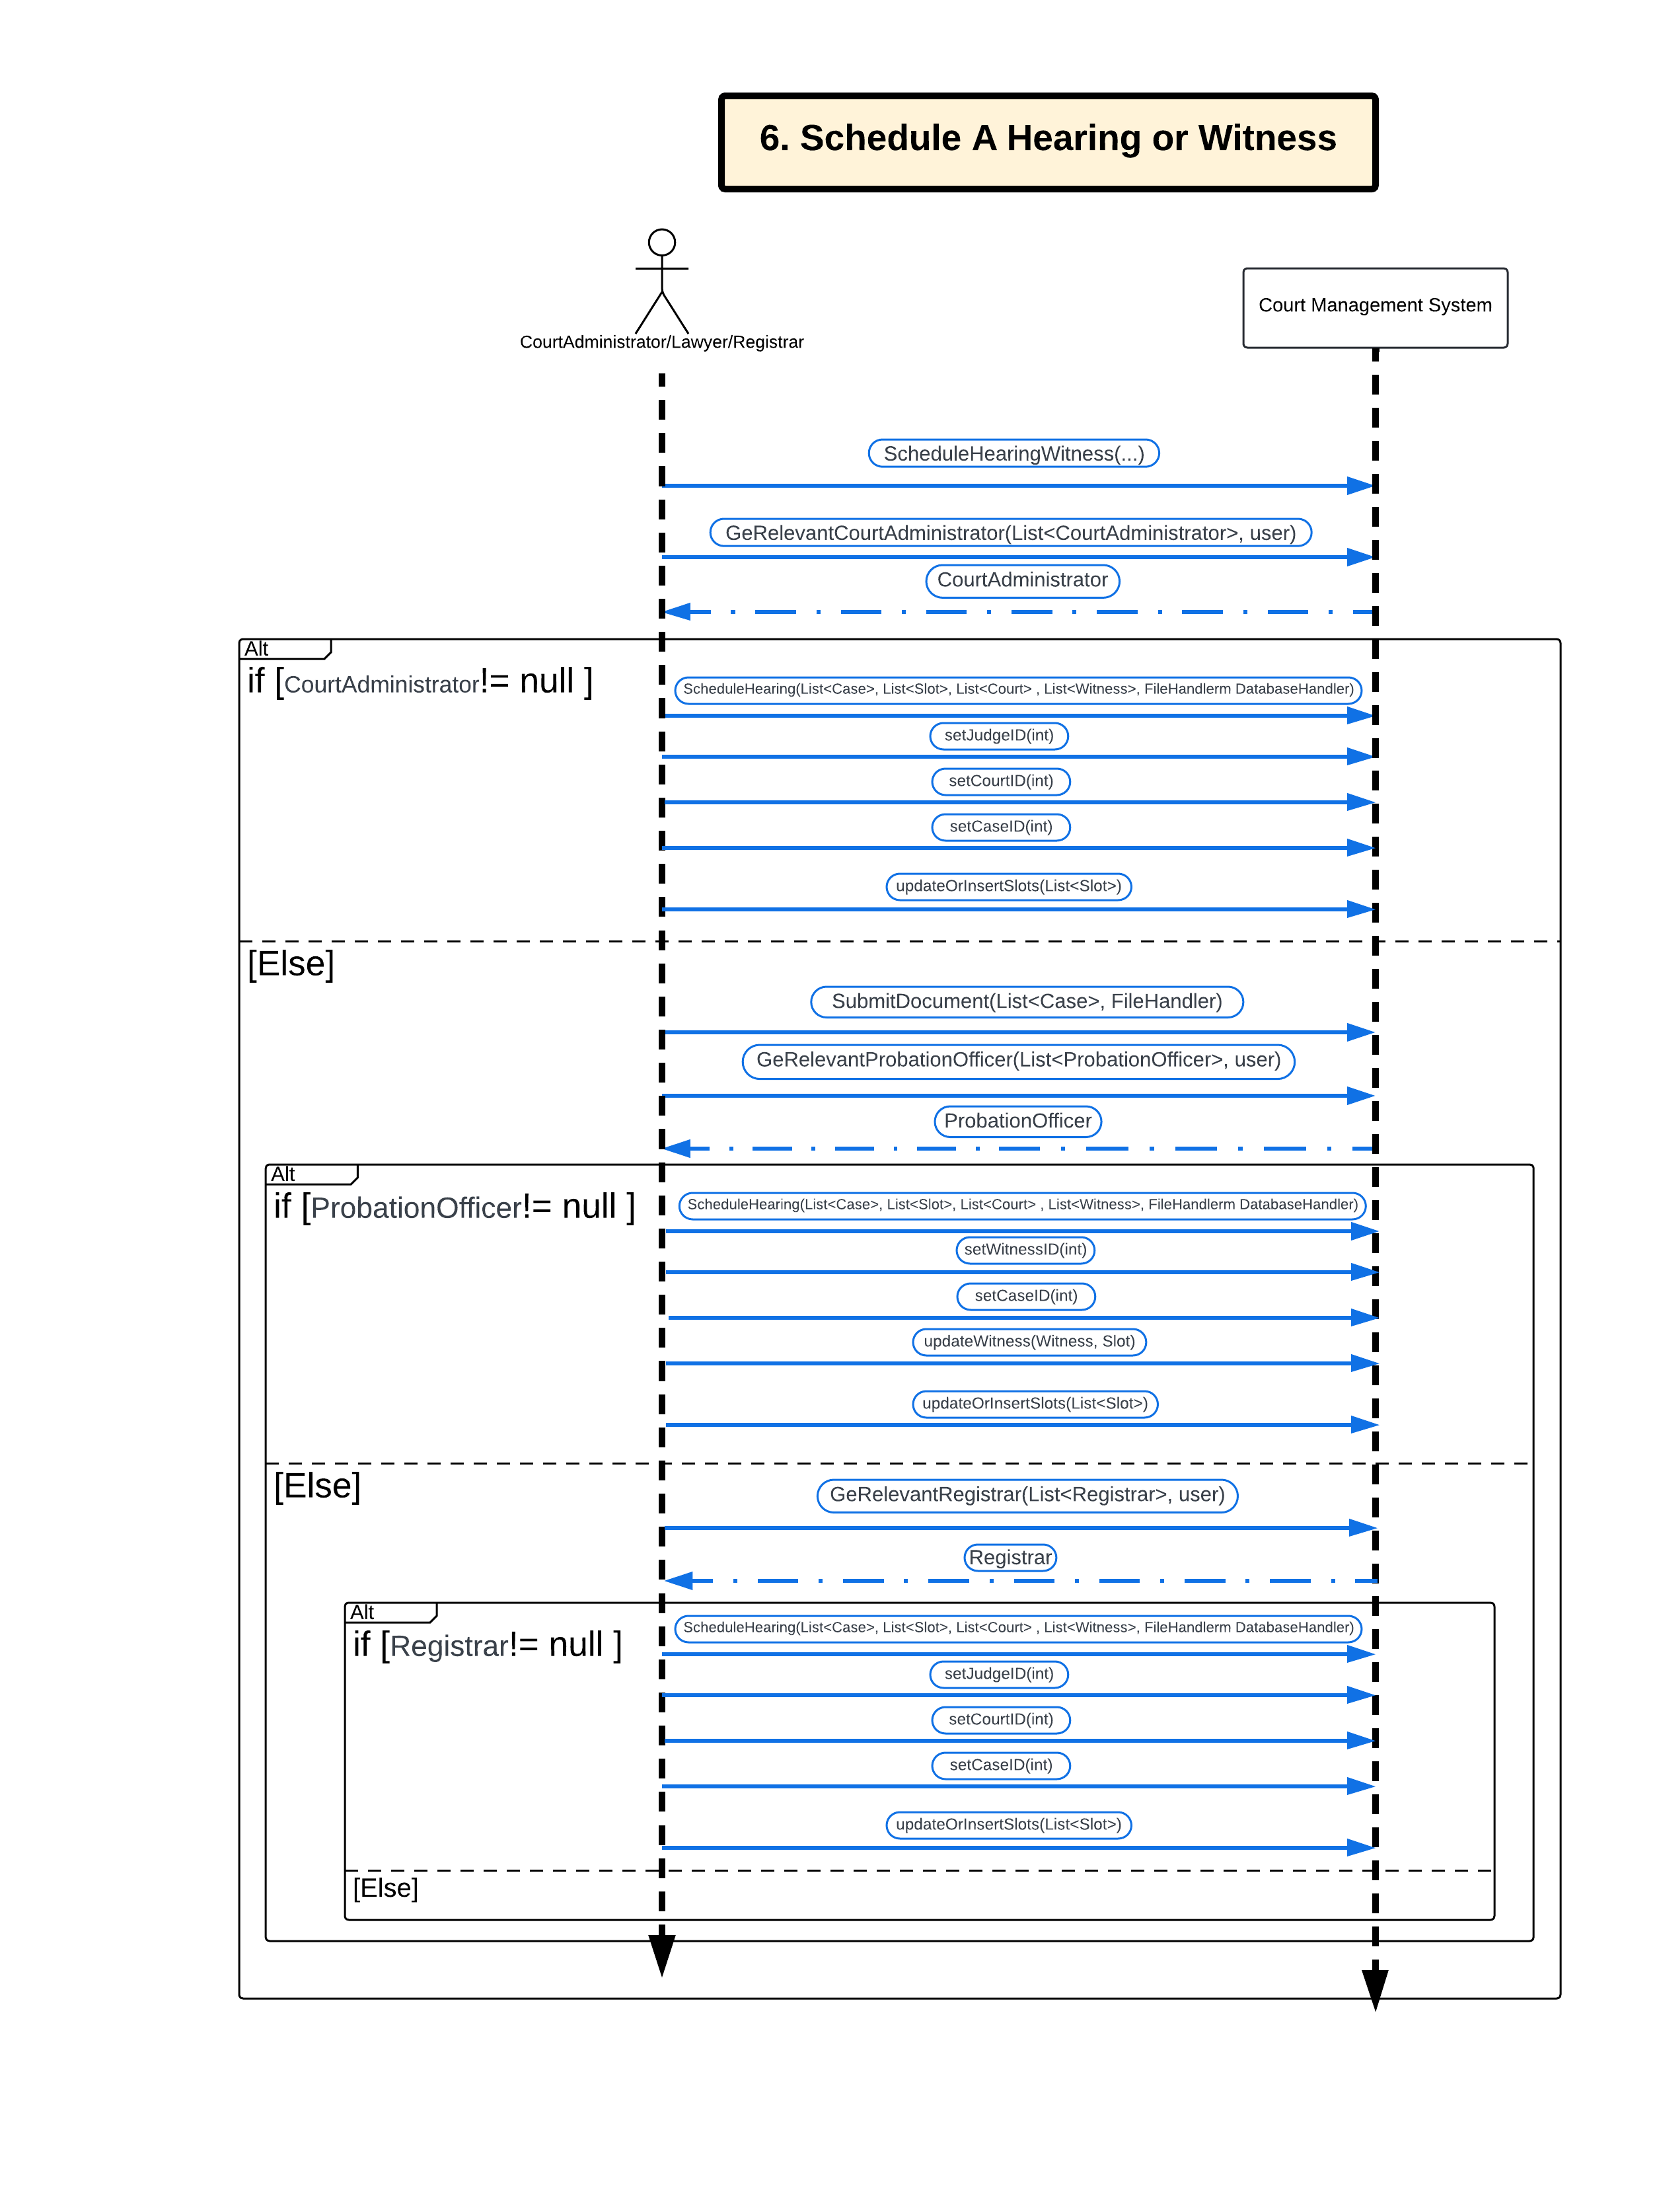
System
Sequence
Diagram
Interaction between
actors and the system.

Slide 19
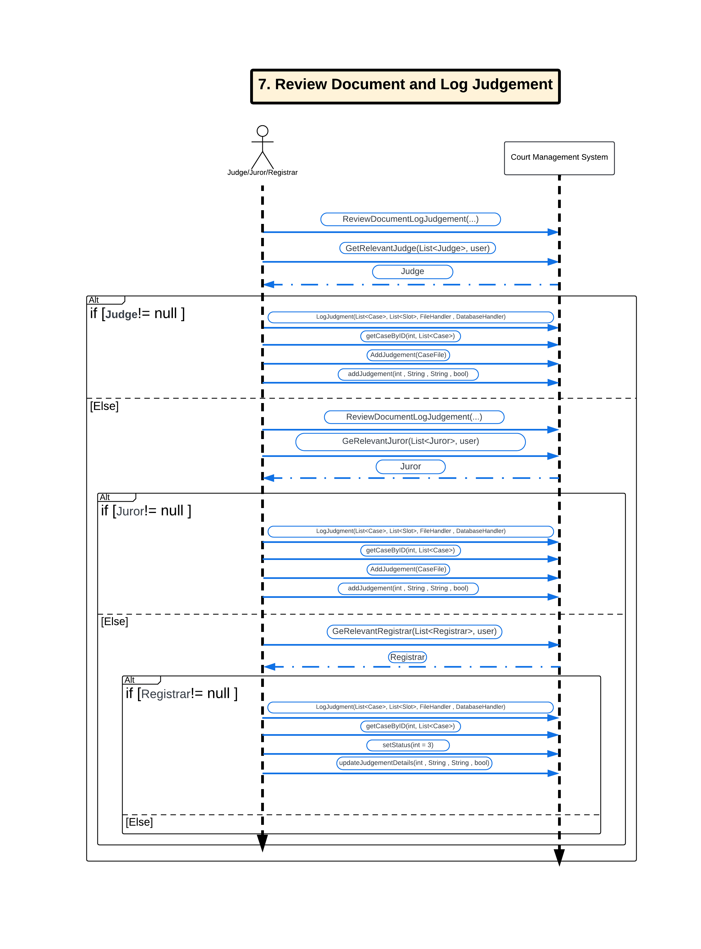
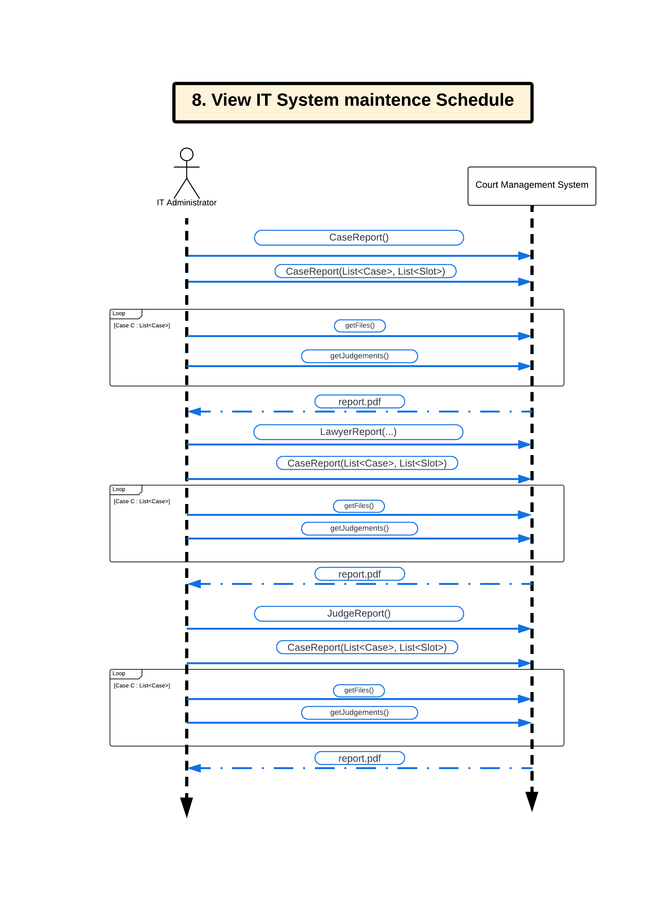
System
Sequence
Diagram
Interaction between
actors and the system.

Slide 20
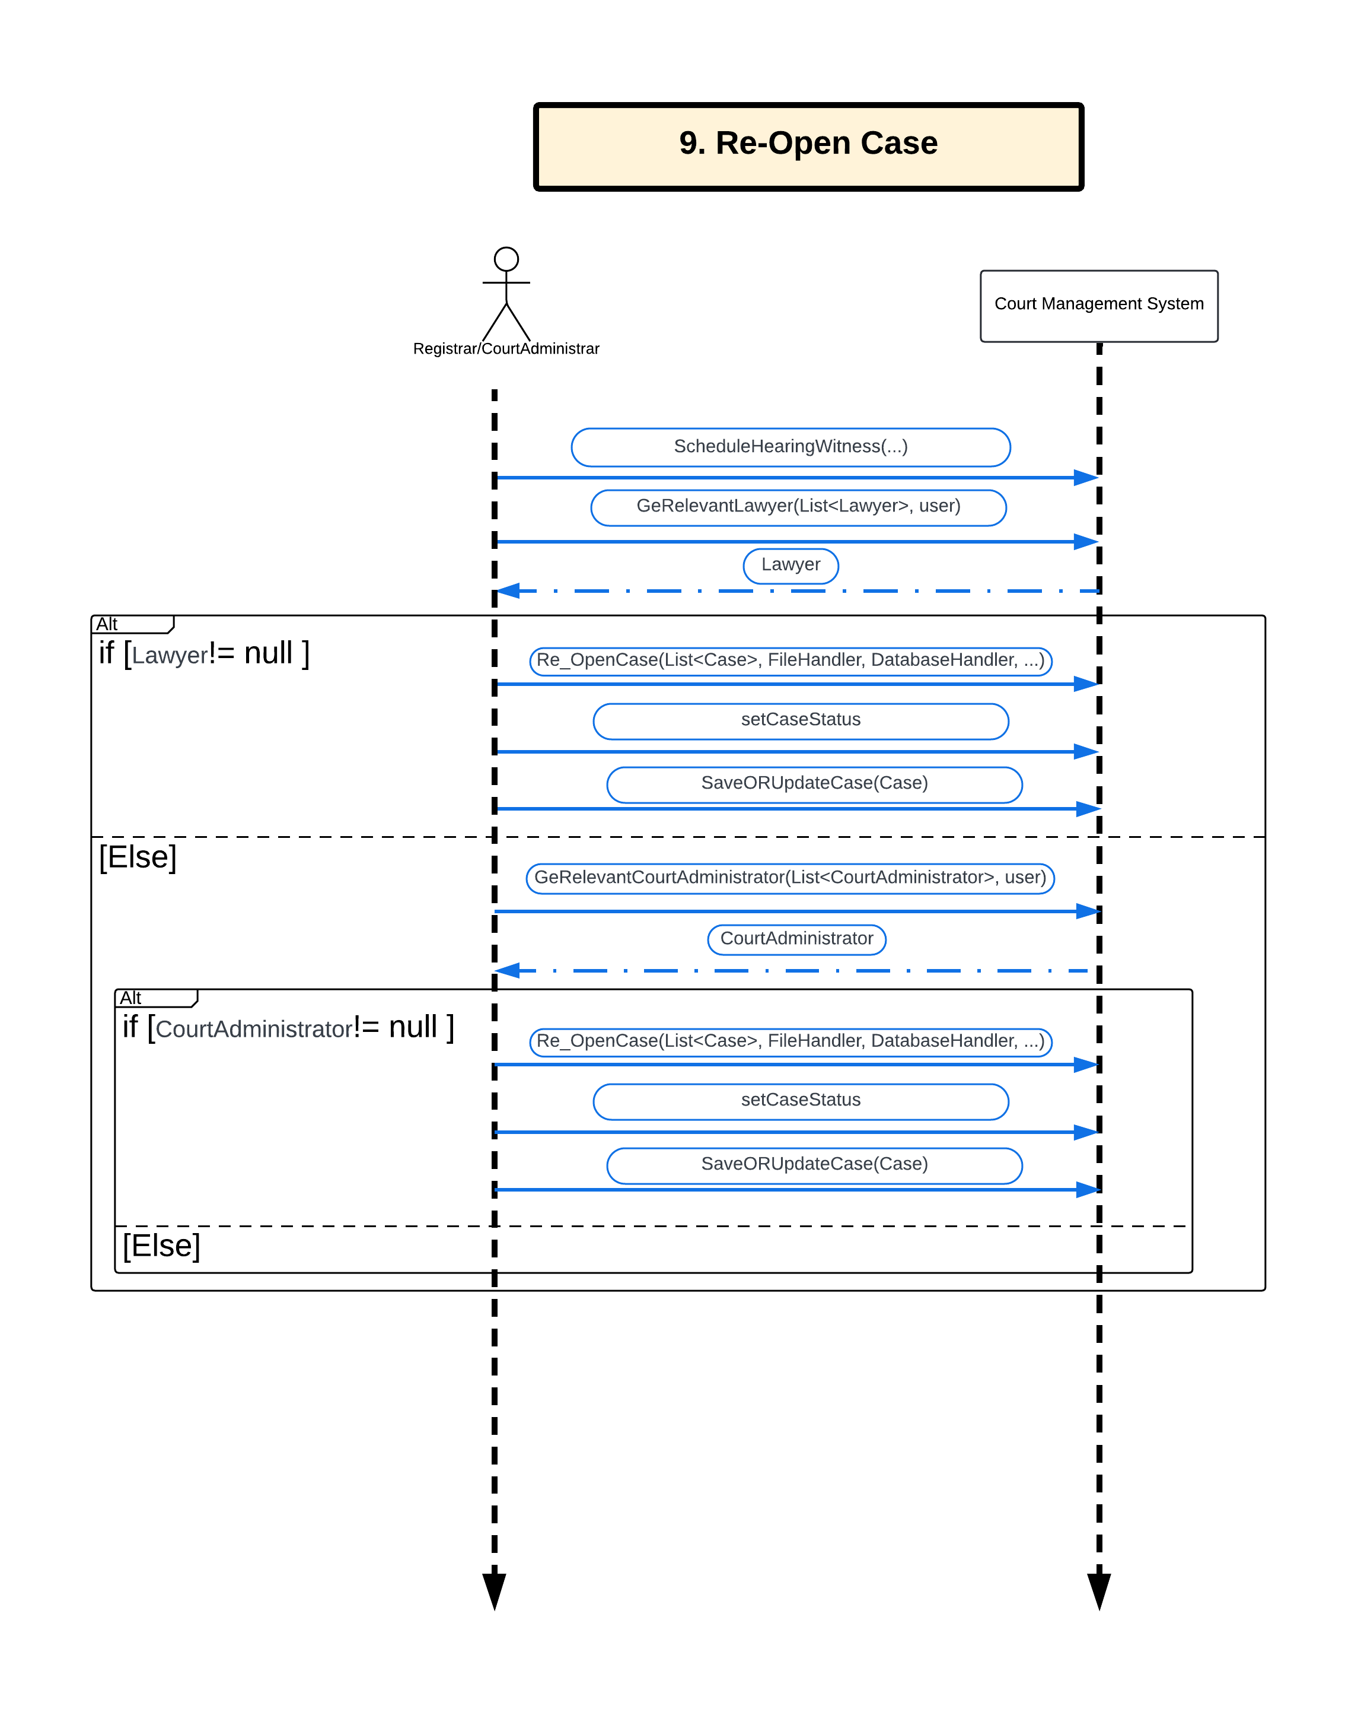
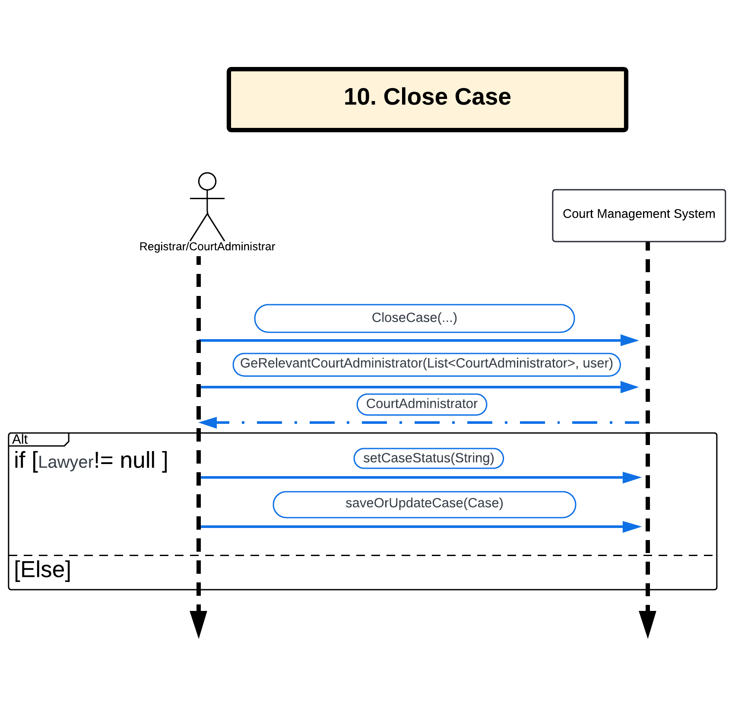
System
Sequence
Diagram
Interaction between
actors and the system.

Slide 21
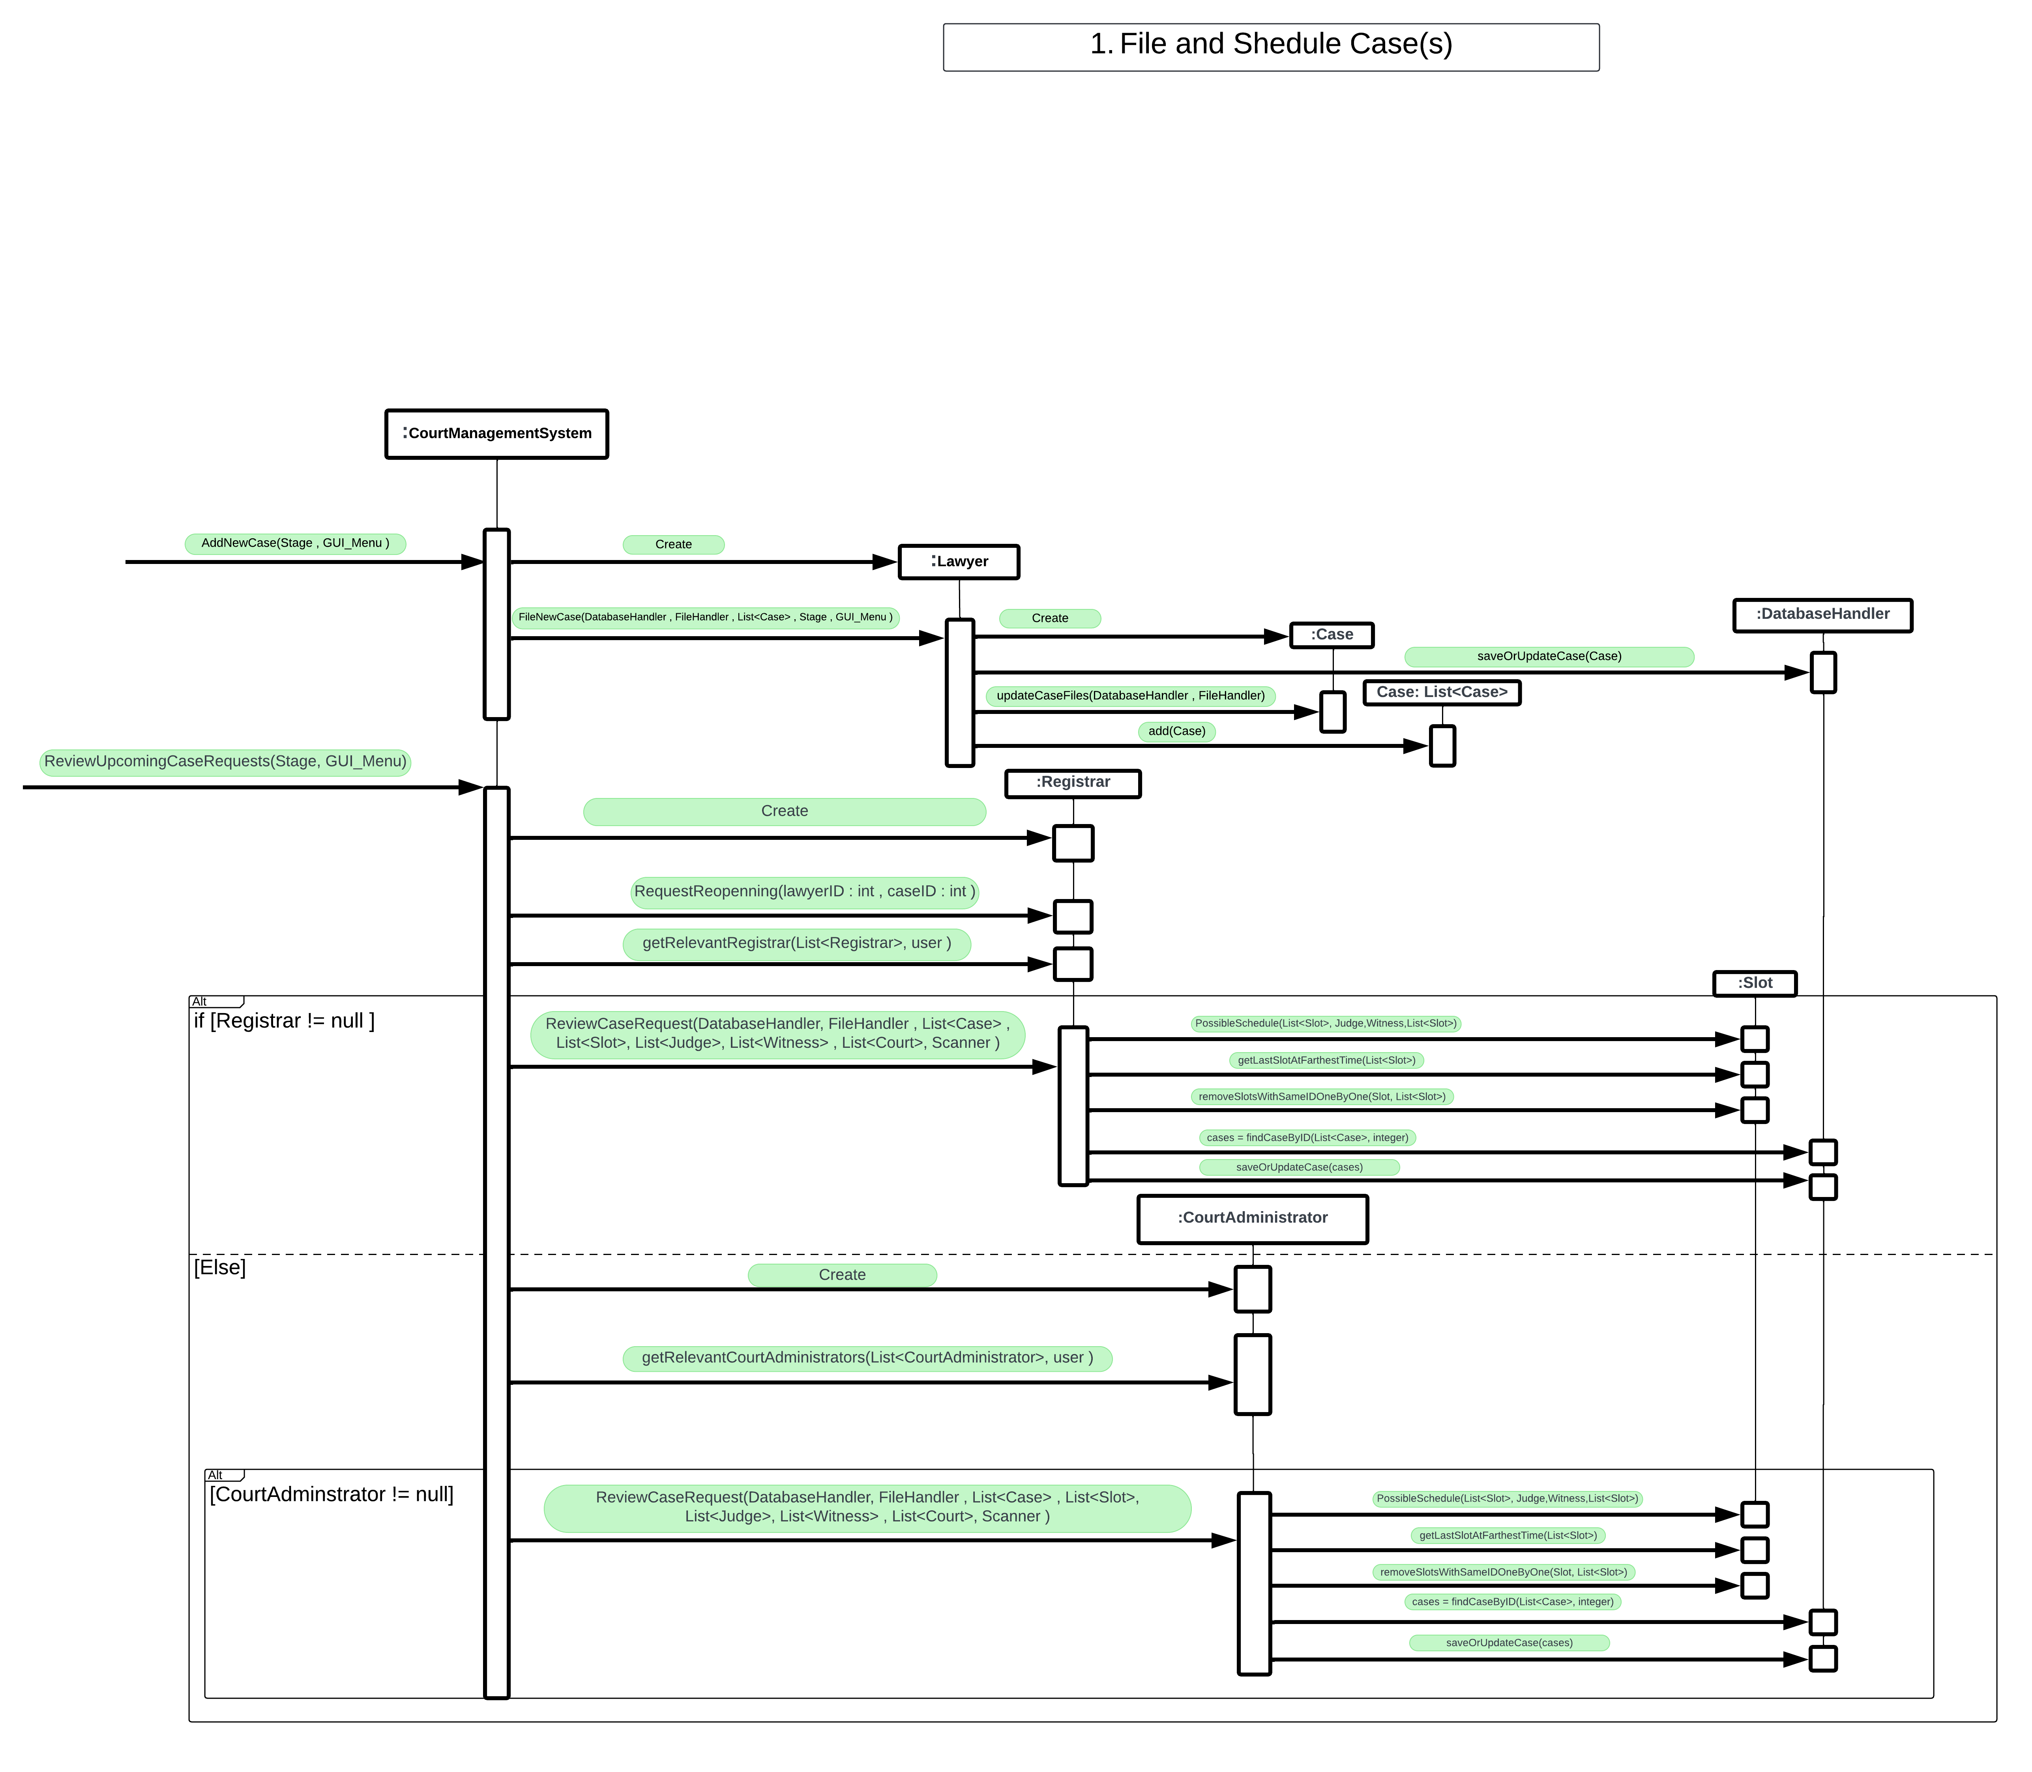
Sequence
Diagram
Interaction between
Classes.

Slide 22
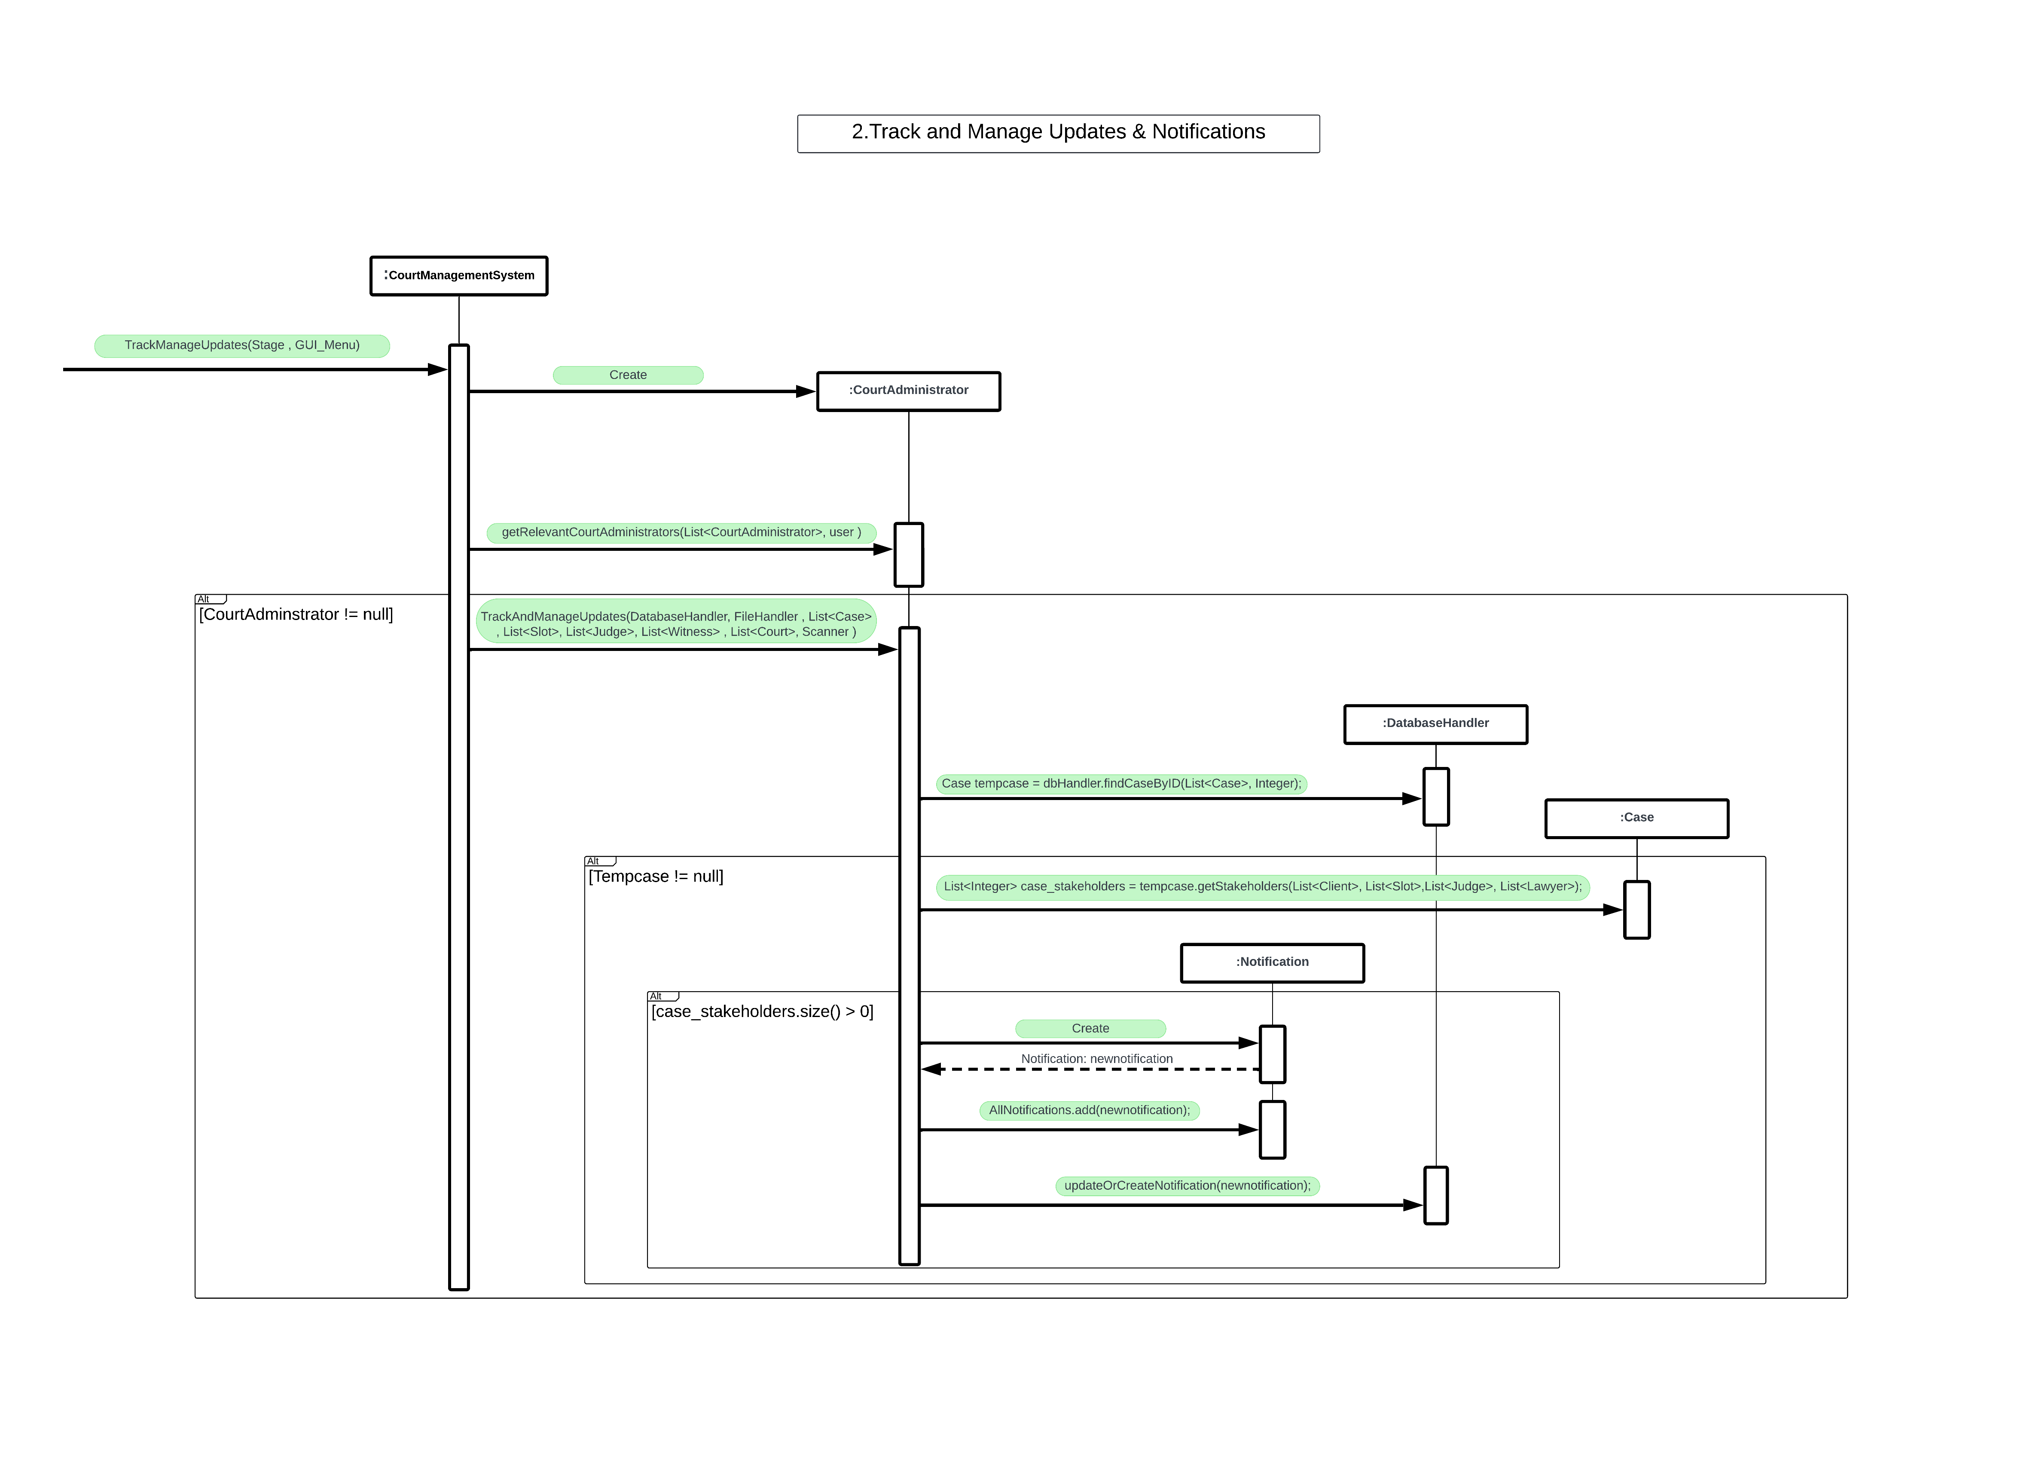
Sequence
Diagram
Interaction between
Classes.

Slide 23
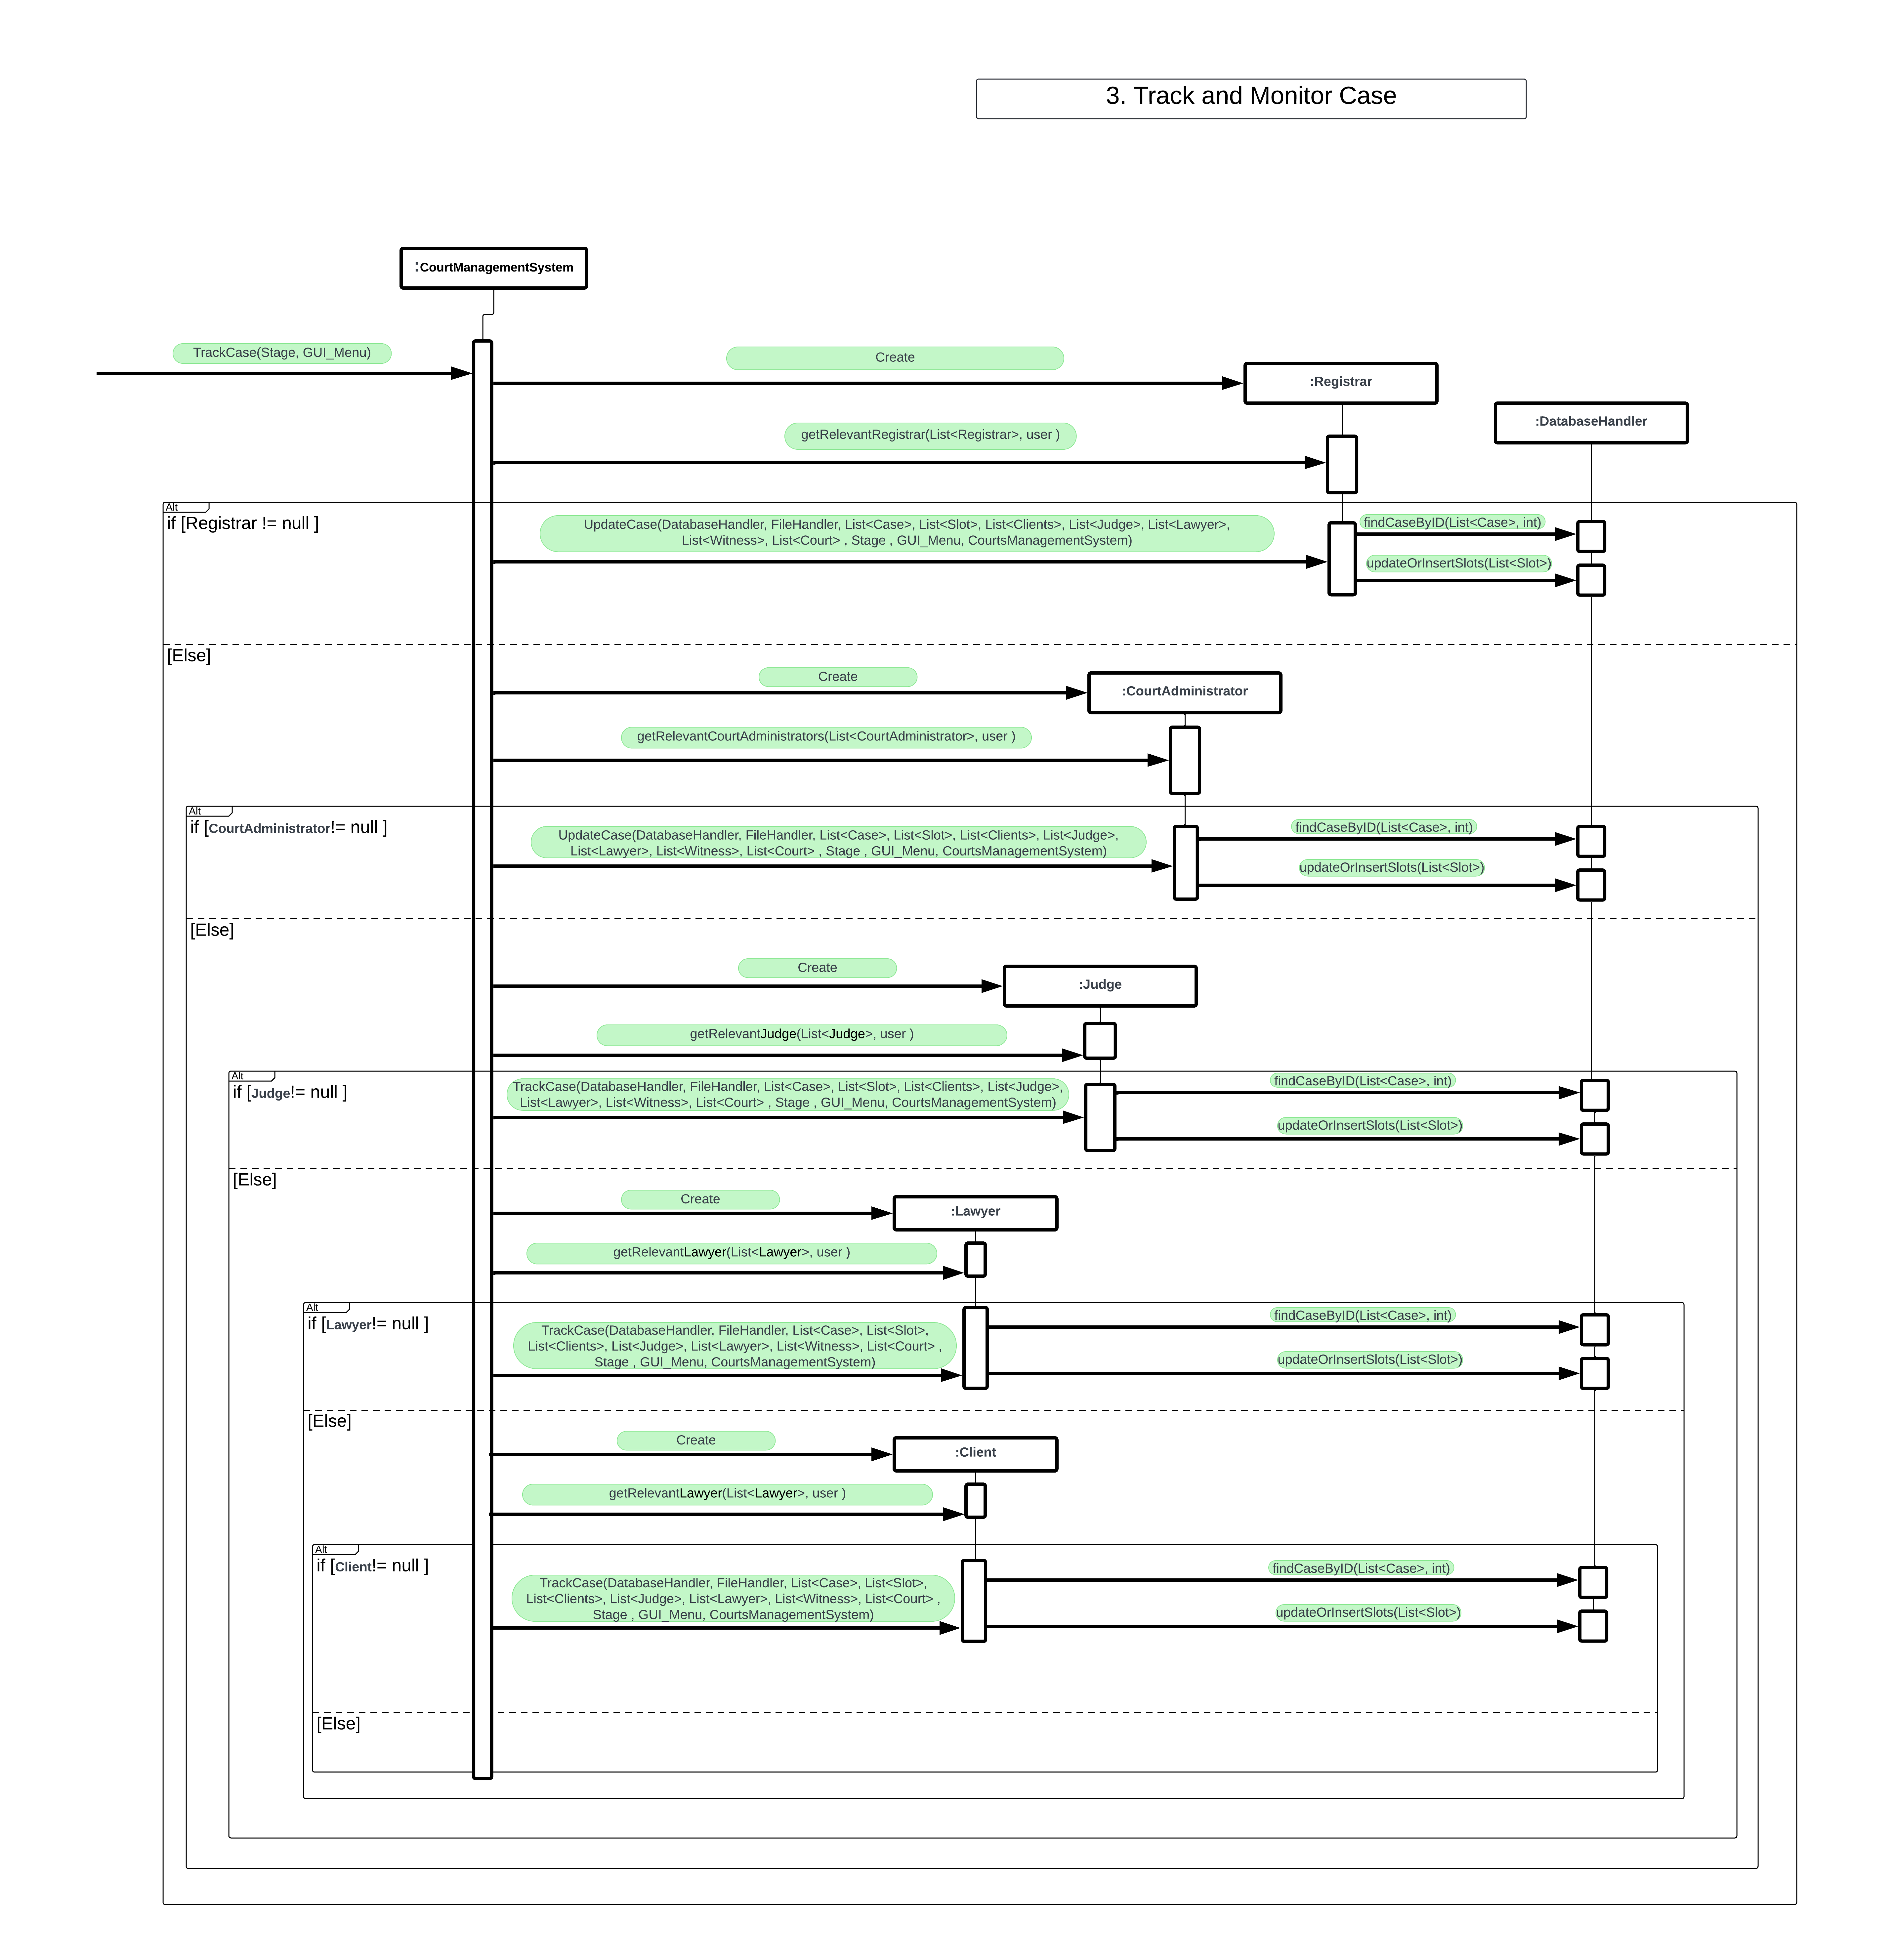
Sequence
Diagram
Interaction between
Classes.

Slide 24
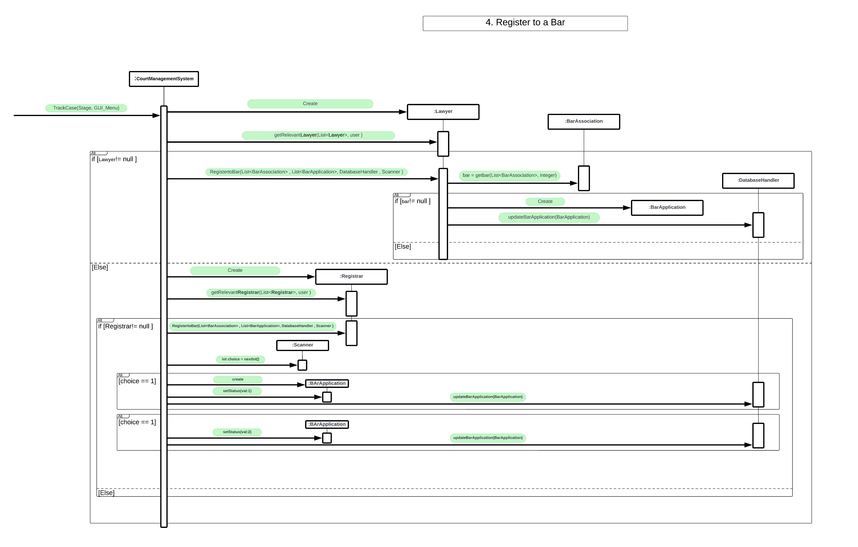
Sequence
Diagram
Interaction between
Classes.

Slide 25
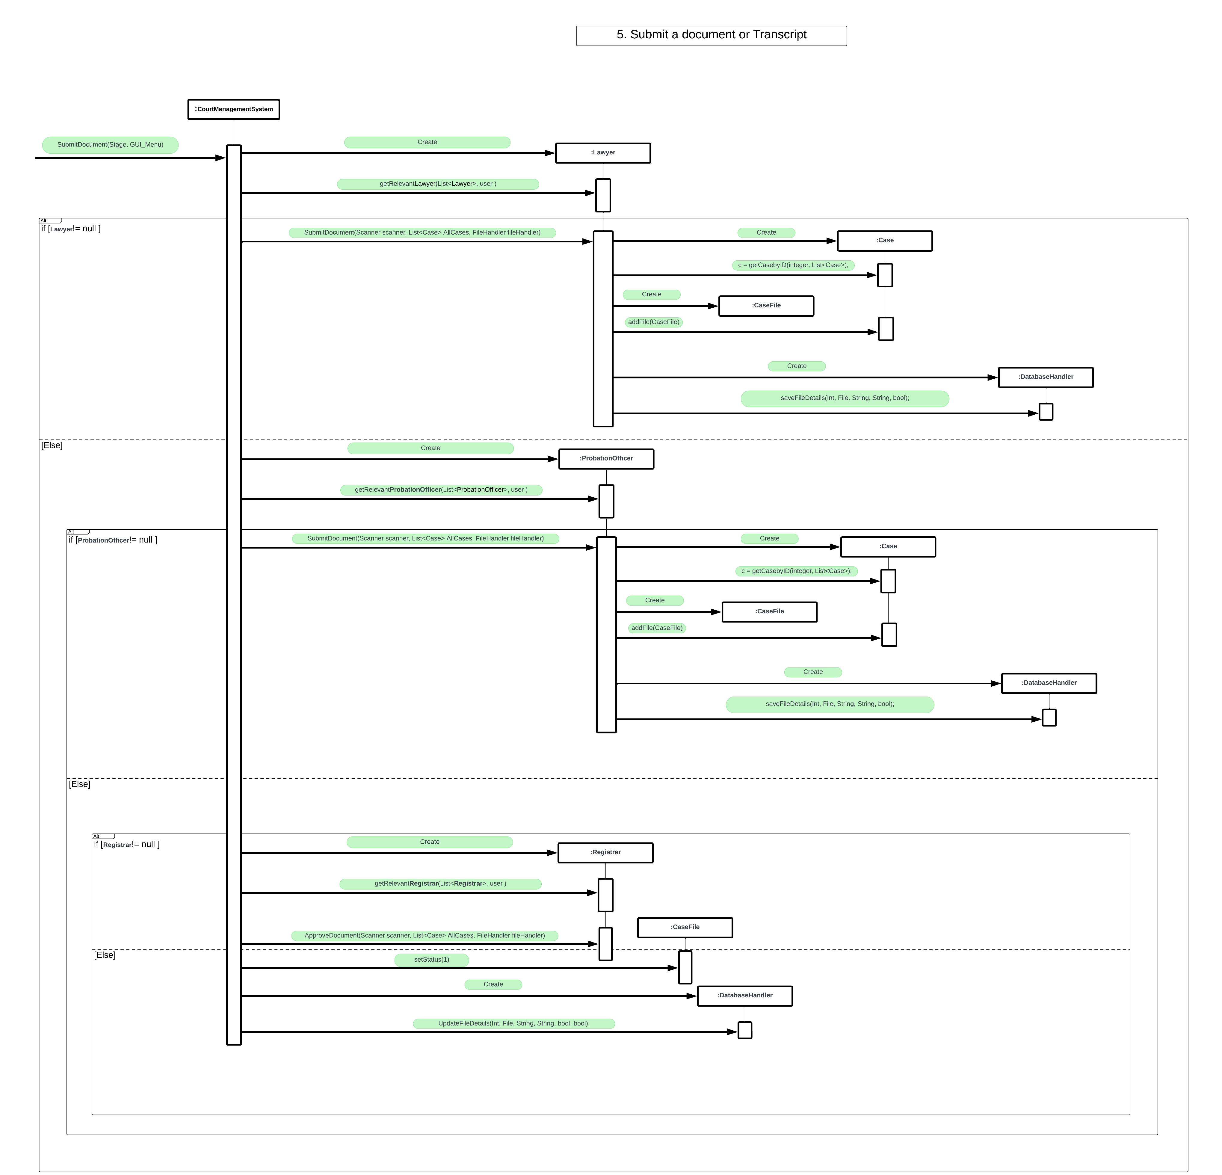
Sequence
Diagram
Interaction between
Classes.

Slide 26
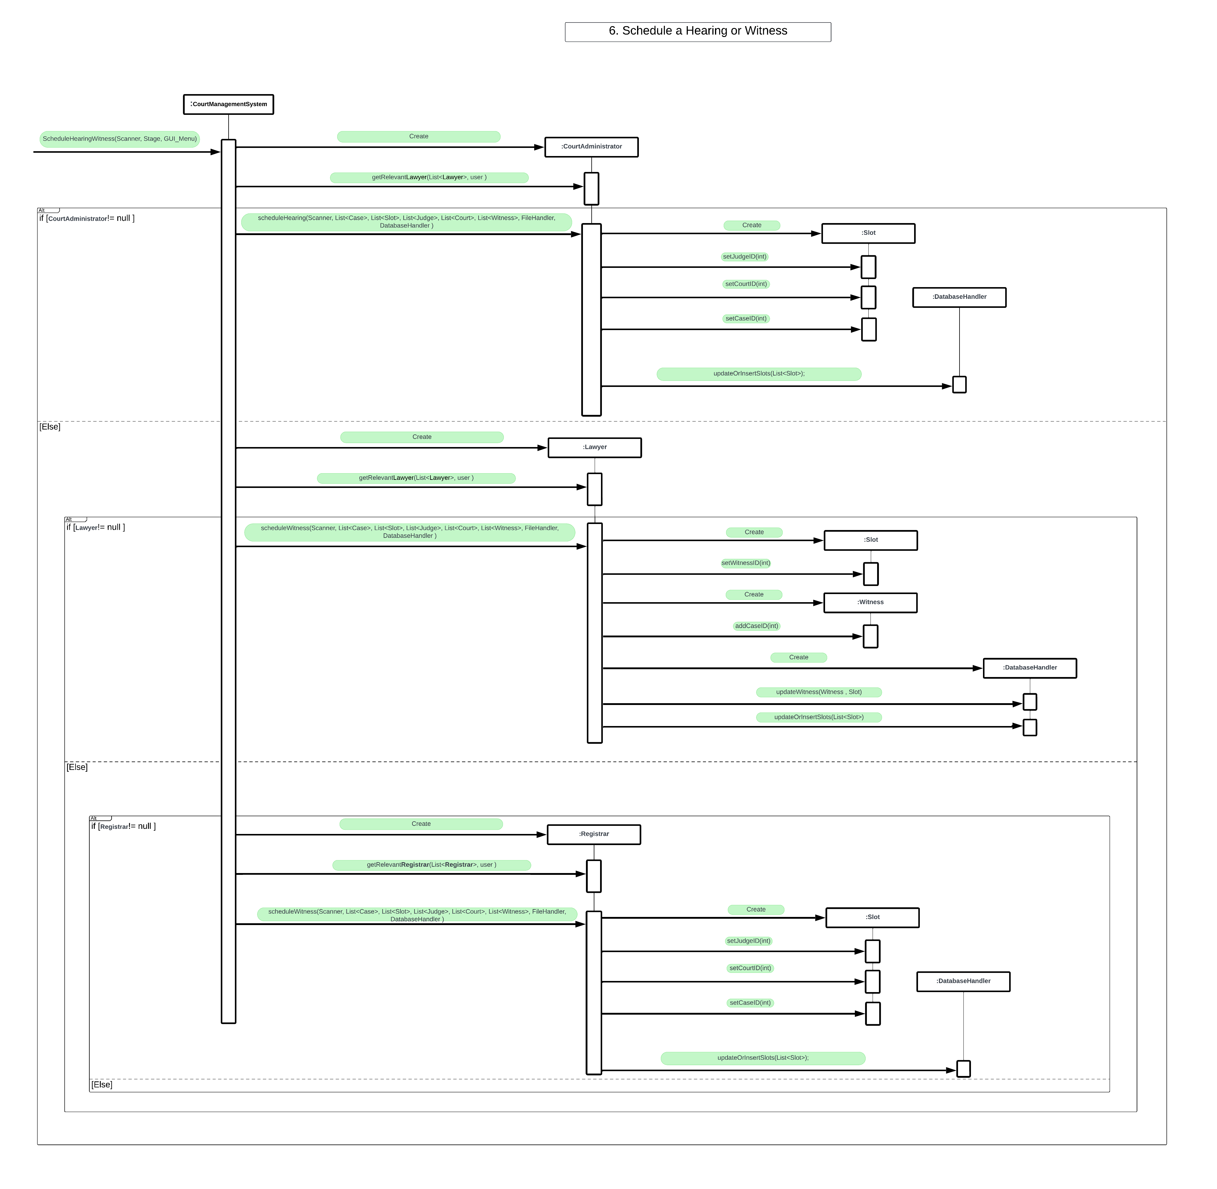
Sequence
Diagram
Interaction between
Classes.

Slide 27
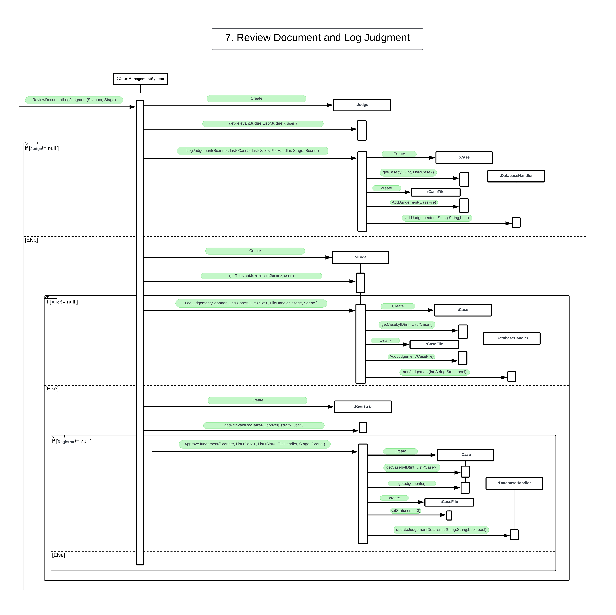
Sequence
Diagram
Interaction between
Classes.

Slide 28
Sequence
Diagram
Interaction between
Classes.

Slide 29
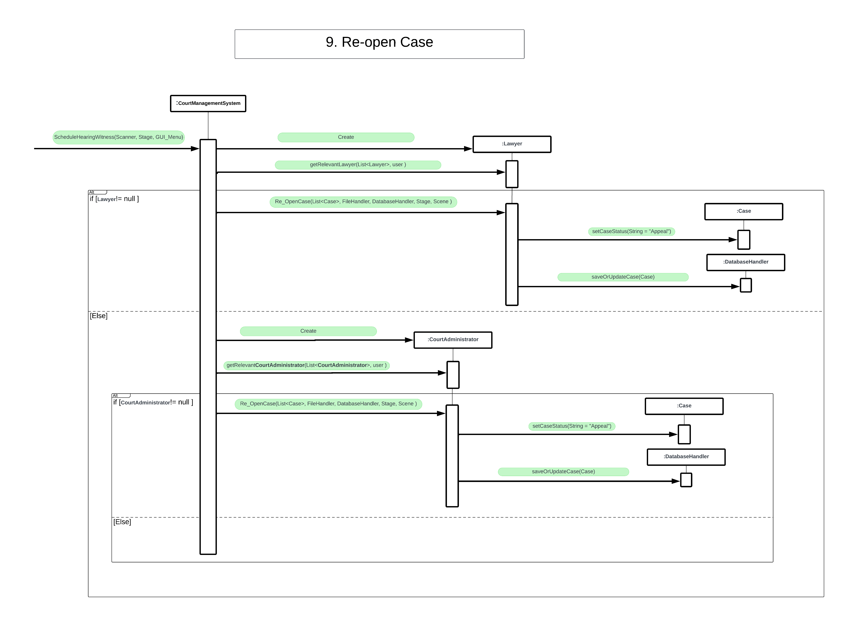
Sequence
Diagram
Interaction between
Classes.

Slide 30
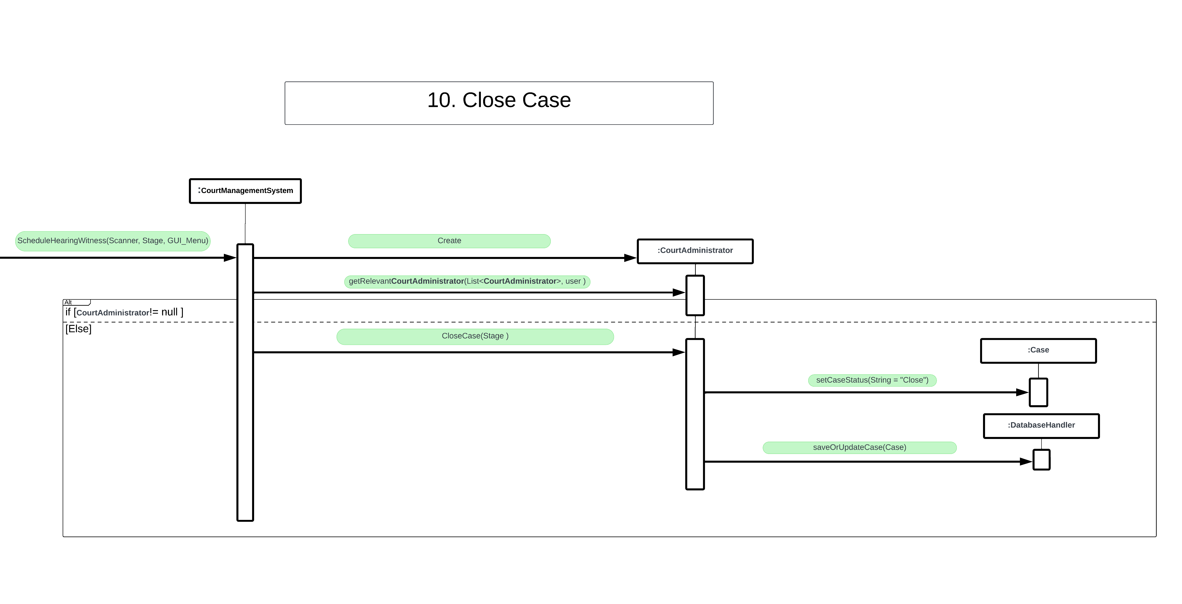
Sequence
Diagram
Interaction between
Classes.

Slide 31
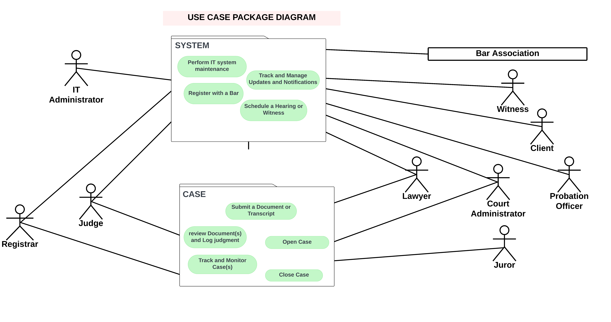
Use Case Package Diagram
Diagram of the system’s packages

Slide 32
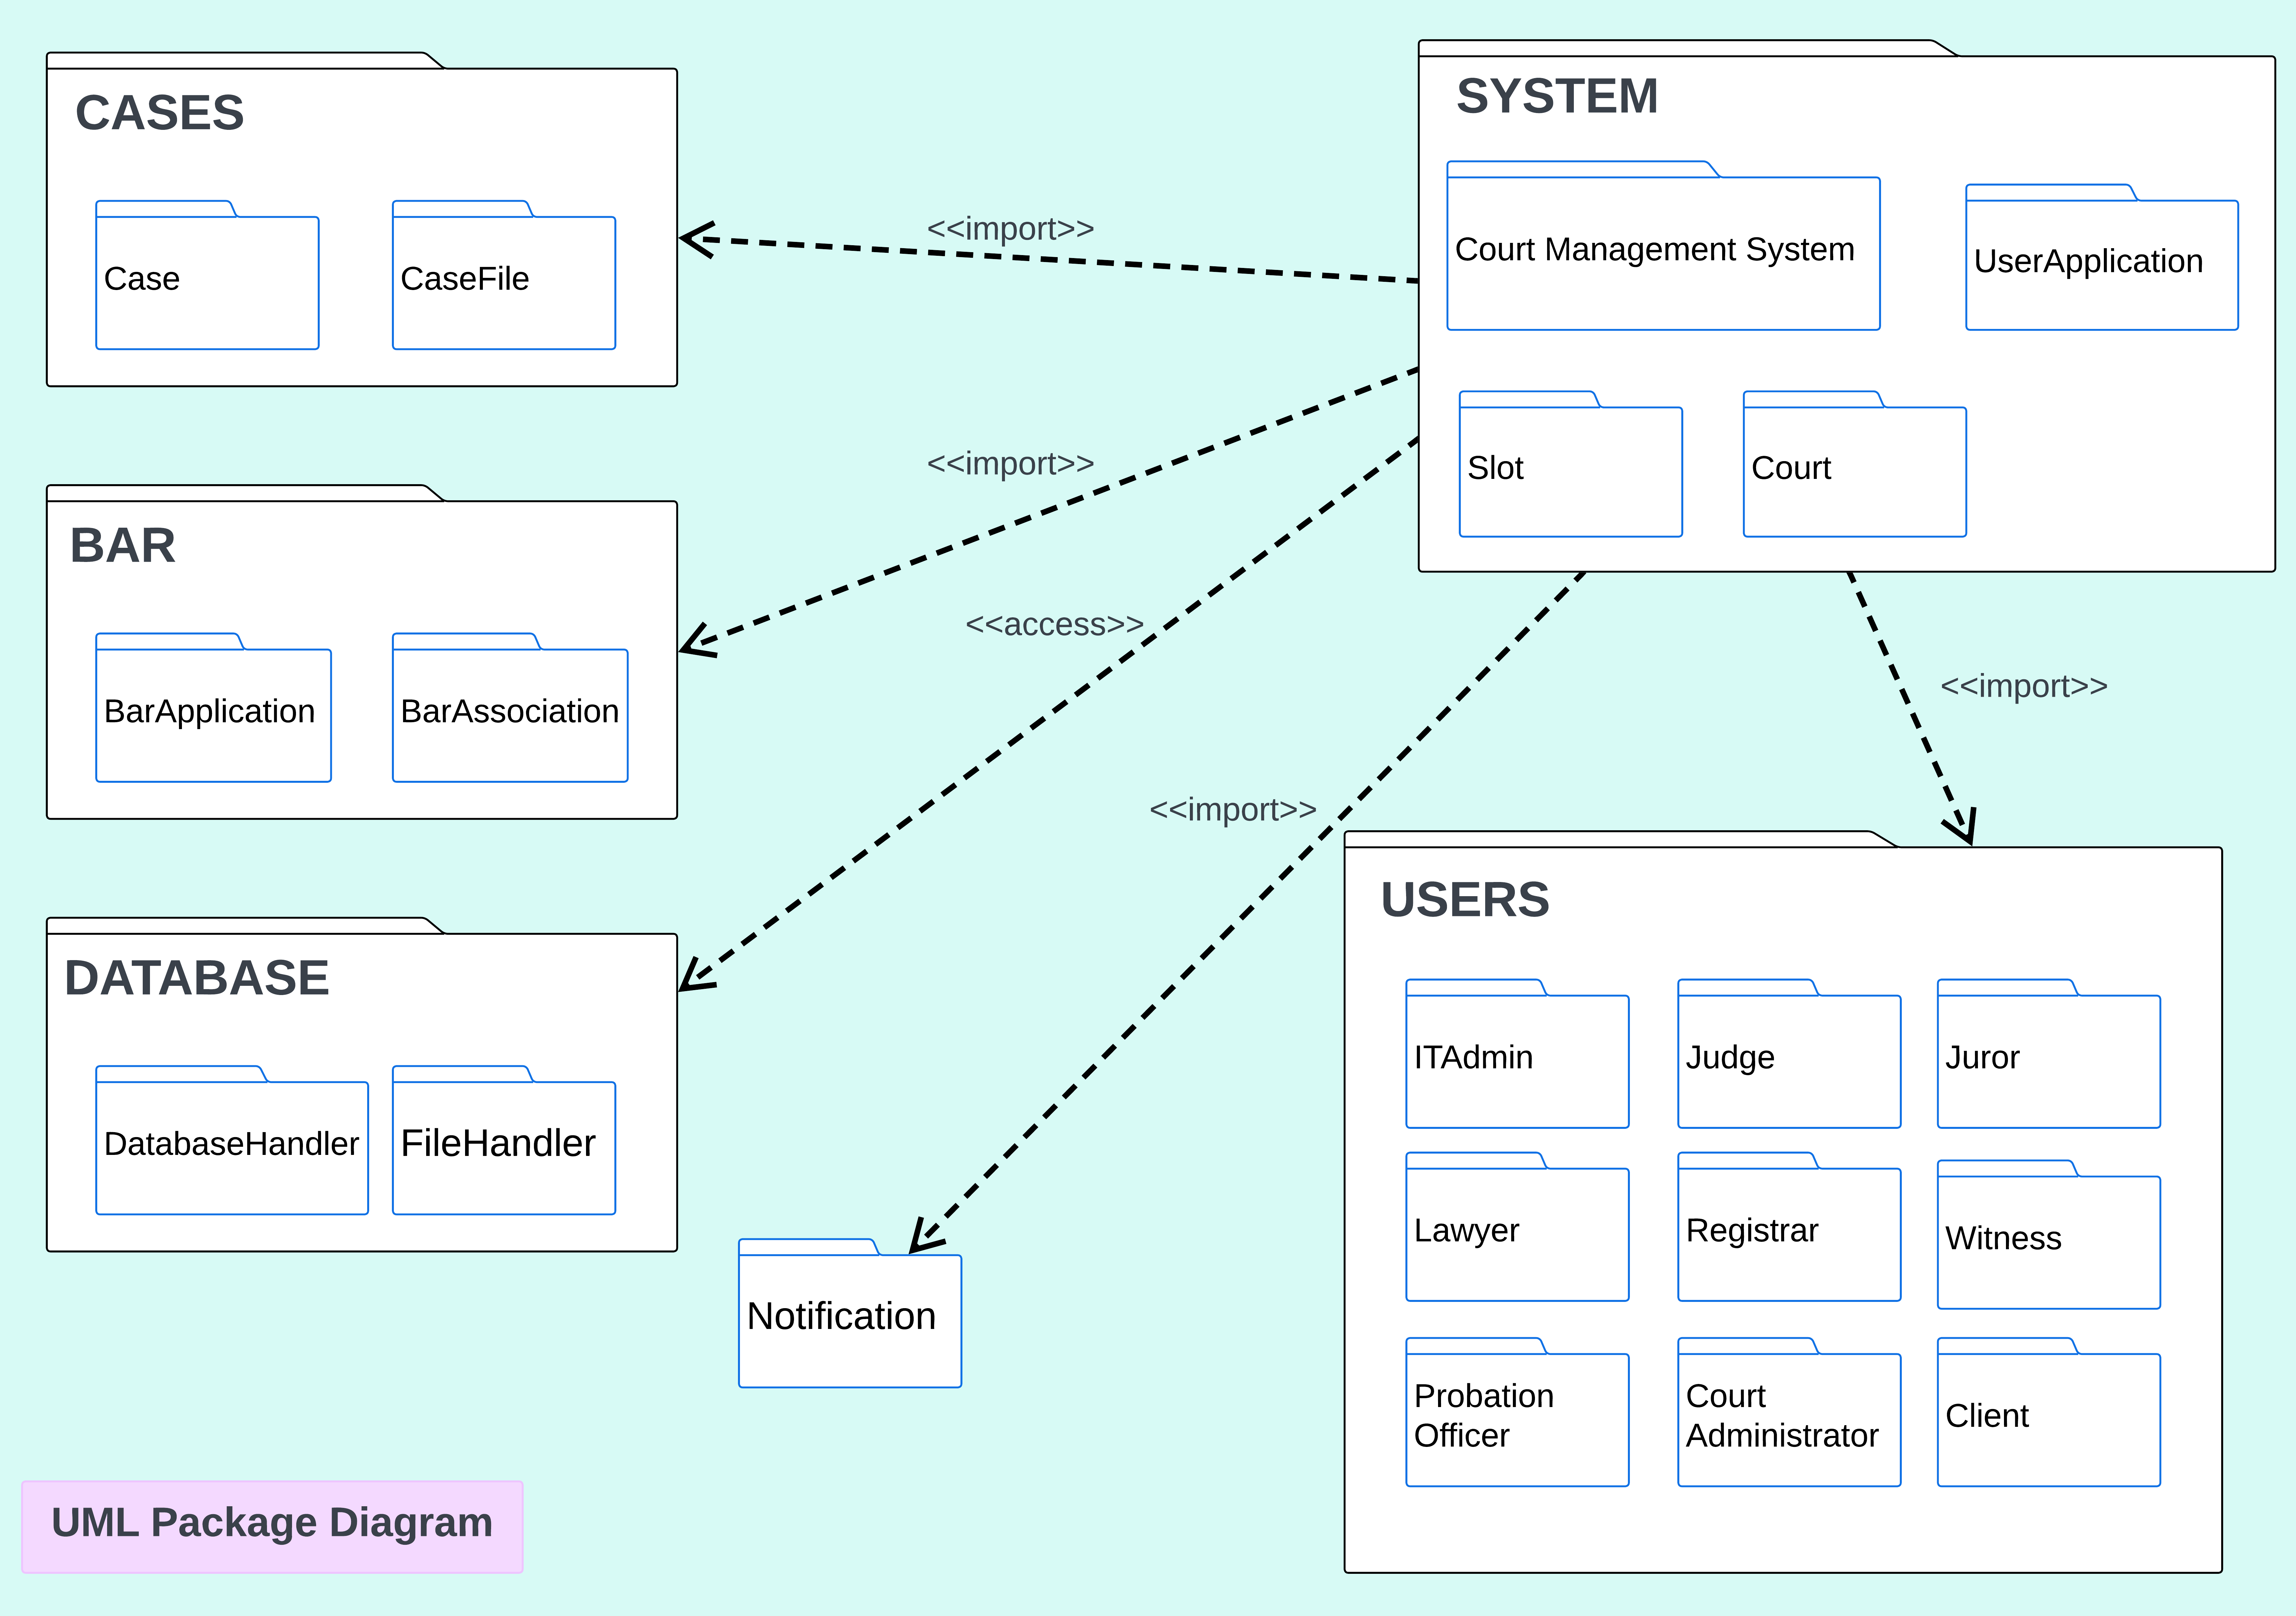
UML
Package
Diagram
Diagram of the system’s packages

Slide 33
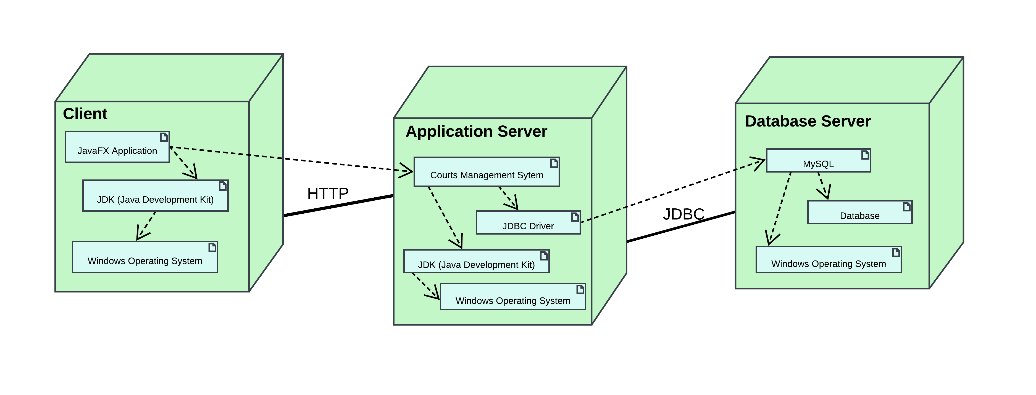
Deployment Diagram
Diagram of the system's physical components.

Slide 34
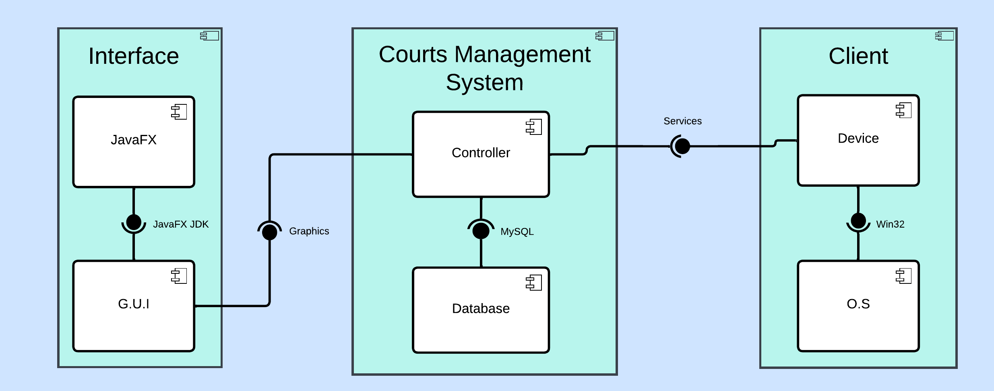
Component Diagram
Diagram of the system's components.

Slide 35

Thank you
Feel free to ask any questions.

